Slide 1
Analysis of Transportation Services for Individuals with Intellectual and Developmental Disabilities
Rob Gregg
Jay Goodwill
Martin Catala
Mitch Spicer
October 5, 2017 l Tallahassee, Florida

Slide 2

Transportation Task Force
CUTR Work Session Agenda – October 5, 2017
CUTR Team Intros
Progress Report - Jay Goodwill
Assessment - Rob
  State-wide Service Networks – Martin Catala
  Funding
  Issues
Opportunities Jay/Rob
  Key Studies
    References
    Best Practices
      Fixed Route Use
      Mobility Options
      Managing Paratransit Costs
      Private Providers / TNC
      Fare Systems
  Focus Areas Jay / Rob
    Coordination
    Customer Care
Incremental Priorities
Final Report Outline
Next Steps

Slide 3
Progress Report
Jay Goodwill

Slide 4
Project Overview
The Agency for Persons with Disabilities has engaged the University of South Florida’s Center for Urban Transportation Research to review and analyze the state’s transportation disadvantaged services (TDS). This effort will examine the design and provision of the state's TDS in urban and non-urbanized areas, identify “gaps” in service accessibility / connectivity and examine strategies of how to assist in the development of integrated services that include the use of the different provider service models.

Slide 5
Project Objectives
Define the target customer TDS populations from a statewide perspective to examine socio-economic characteristics and geographical travel relationships.
Examine the design and provision of the state’s TDS in urban and non-urbanized areas to assess network design, accessibility barriers and opportunities for improvements.
Define gaps in TDS service accessibility, connectivity and coordination.
Examine service options and model mobility delivery strategies to assist in addressing the service gaps and to provide enhanced TDS mobility services, to include service delivery using different provider model concepts.

Slide 6
Project Service Goal
The study service goal is to provide an examination of the state’s transportation disadvantage and other transportation services for individuals with intellectual and developmental disabilities, how services are provided in urban and non-urbanized areas, and assist in the development and use of different provider models.

Slide 7
Project Timeline
Initiated discussion on June 6, 2017
Executed contract on August 22, 2017
Statement of Work – submitted on August 18, 2017 and finalized on September 6, 2017
Transportation Task Force Meeting Schedule:
  #1: July 6, 2017 (by phone)
  #2: August 2, 2017 (Tallahassee)
  #3: September 20, 2017 => rescheduled to October 5, 2017
  #4: To Be Determined

Slide 8
Project Timeline (continued)
Draft Final Report scheduled for October 23, 2017
  Due to Task Force Delay, have requested change to October 30th
Final Report scheduled for delivery on November 27, 2017
  No delay in submittal requested
APD and Task Force Review of Final Document
Final Report will be submitted by December 6, 2017
Contracted August 22nd
Progress Report
Task Force III
Draft Report
Final Report
24 Days
Irma
44 Days
69 Days
106 Days

Slide 9
Project Progress Report Organization
The Project Progress Report was submitted on September 15, 2017
Due to the compressed project schedule, the Project Progress Report was organized by presenting information as available by the Tasks and Sub-Tasks from the Statement of Work
It should be noted that the document was not presented in a final report format, but rather as an assortment of information, data and graphics
This information as well as additional information gathered and compiled since September 15th will provide the basis for today’s presentation
The Draft Final Report Outline was included and will be discussed later today

Slide 10
Situation Assessment
  State-wide Service Networks
  Funding
  Issues

Slide 11

Organizing Analysis
Private Partnerships
Reduce
Fragmentation
Transfers and
Wait Times
Service
Improvements
Regional Fare
Systems
Inter / Intra City
Customer
Communication
Urban vs. Rural
Environment

Slide 12


Study Approach
Assess
Issues
Environment
Research
Best Practices
Innovative Examples
Opportunities
Alternatives
Recommendations
Findings

Slide 13
Service Types
Briefing
Mitch Spicer and Rob Gregg

Slide 14
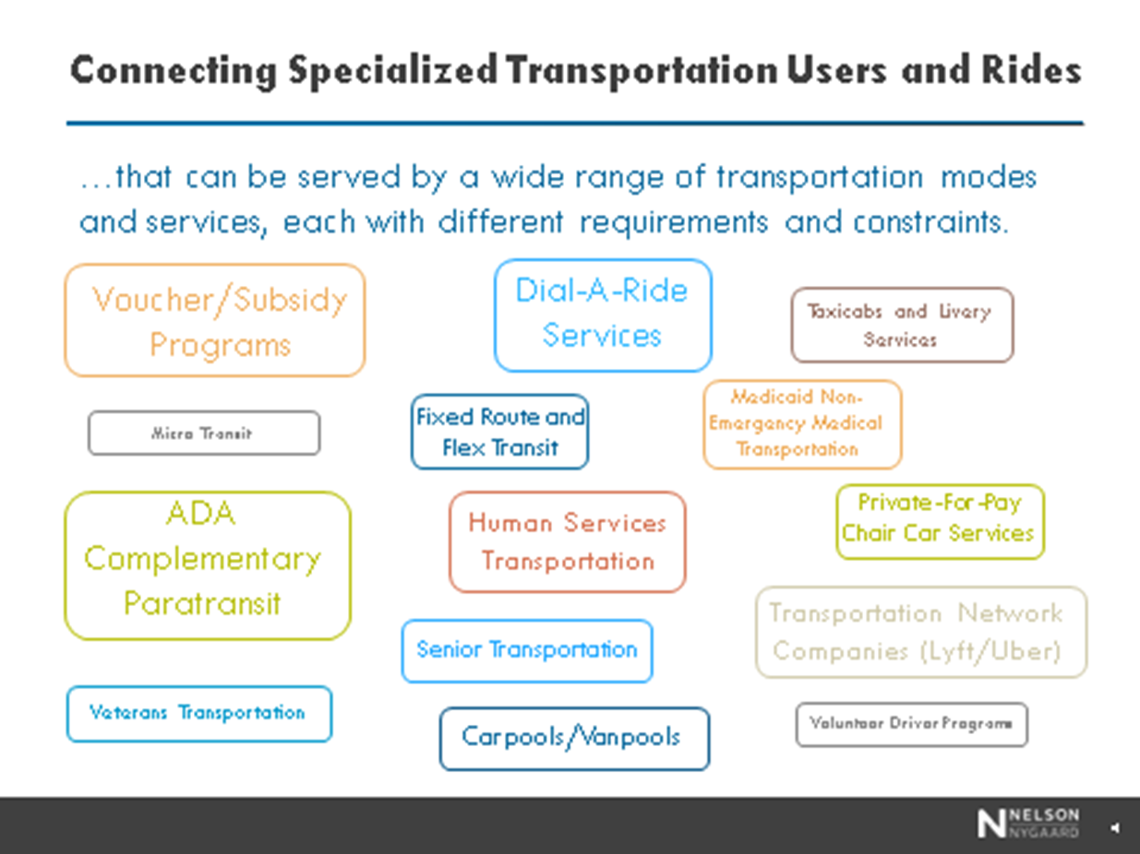
Examining Mobility
Options and Service Delivery Models

Slide 15
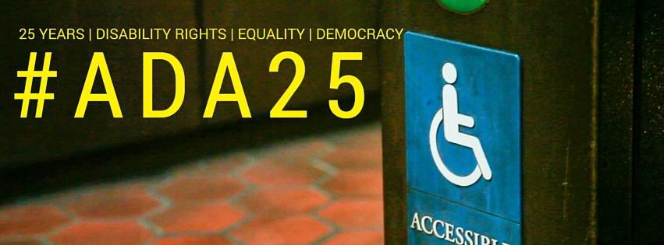
The Americans with Disabilities Act
The Americans with Disabilities Act (ADA) [P.L. 101- 336, 42 U.S.C. 12101, et seq.] of 1990 is a wide-ranging civil rights law banning discrimination against people with disabilities. It defines disability as a condition that substantially limits a major life activity.
All public transportation service in the United States are required to comply with the ADA.
Not every service model is required to provide complementary paratransit however

Slide 16
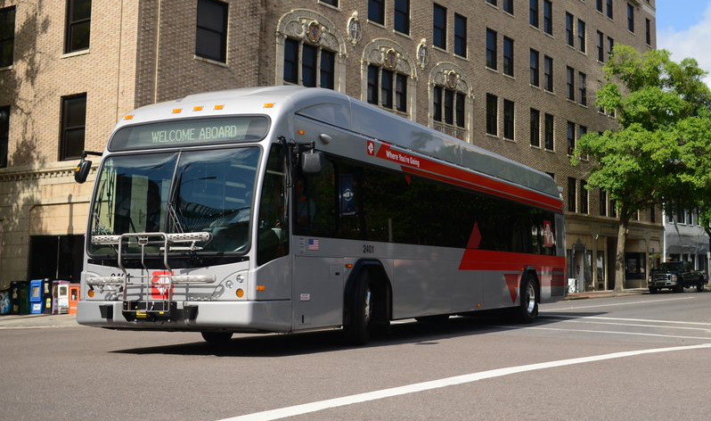
Fixed Route Service and
Accommodating Accessibility
Responsible for
Non-discrimination
Maintaining accessible features
Keeping lifts and ramps in operative condition
Using lifts and securement systems
Priority seating and securement areas
Adequate boarding and disembarking time
Boarding assistance
Stop announcements
Route identification
Complementary paratransit
Fixed route service is a traditional bus service that that transports the general public on a regular basis on vehicles that travel a designated route on a fixed schedule

Slide 17
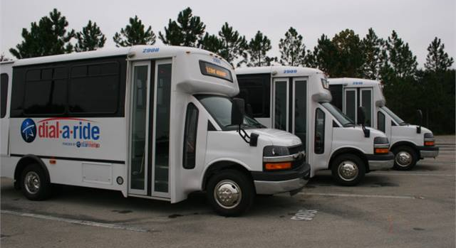
Demand Response and
Dial-a-Ride Service
Does not solely provide services to the paratransit market.
Enhances the mobility of people who either cannot drive, are unable to use or do not have access to a fixed-route system, or simply prefer to use the demand-response system
Provides mobility to people who otherwise would be unable to travel at all
Transit agencies dispatch vehicles in response to a patron’s request while accommodating other patrons with similar geographical requests.

Slide 18
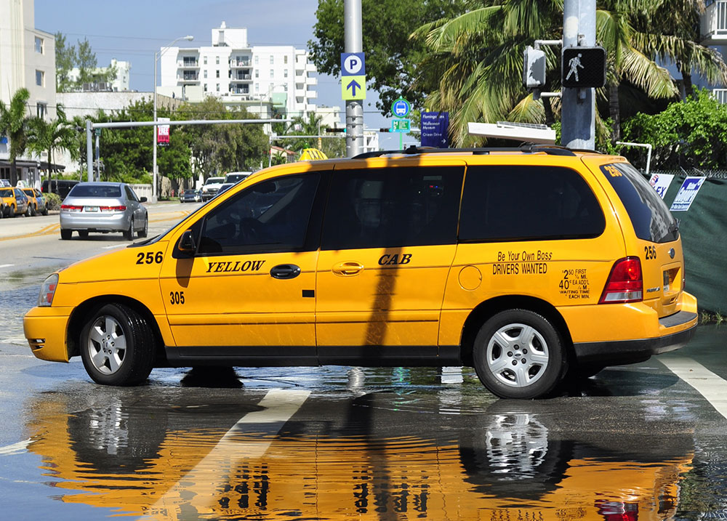
Taxi Services and
Accessible Service Integration
A vehicle, usually fitted with a taximeter that may be hired, along with its driver, to carry passengers to any specified destination
Stricter supervision and training when compared to TNCs
Some transit agencies contract with taxis to provide ADA-eligible trips
Could contract out these trips to taxi companies that have wheelchair-accessible cabs to provide revenue during times when taxi hails are low

Slide 19
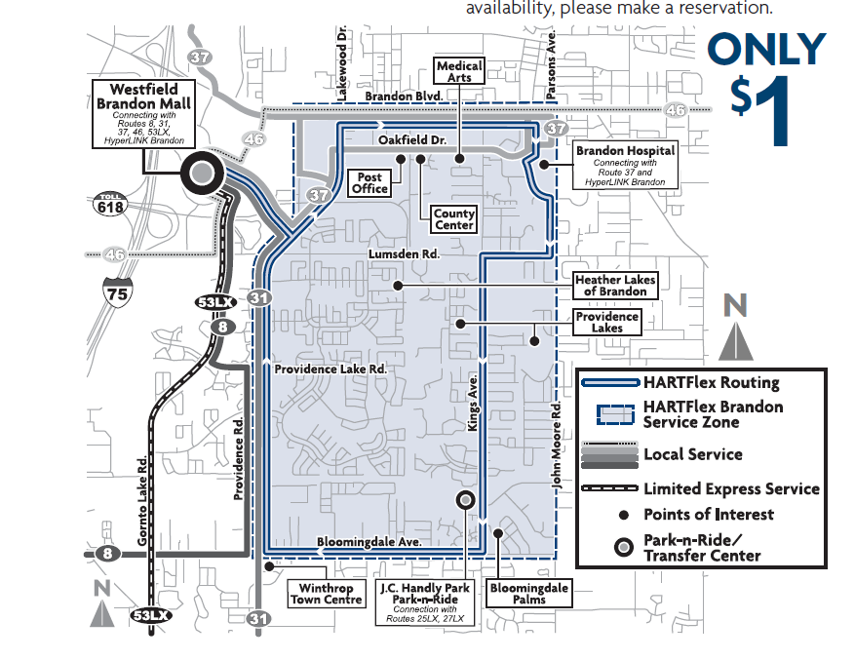
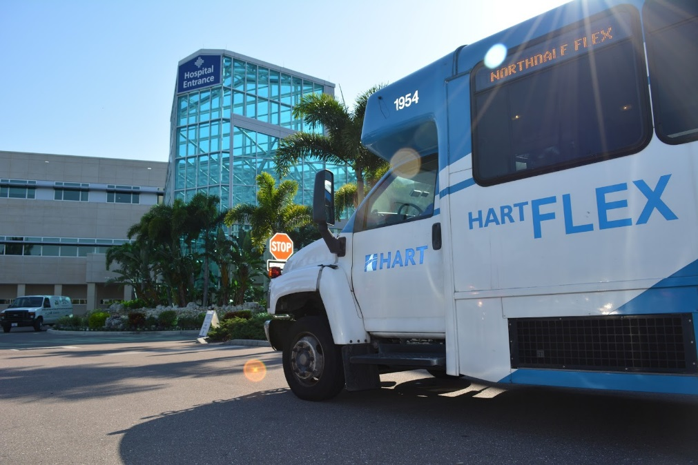
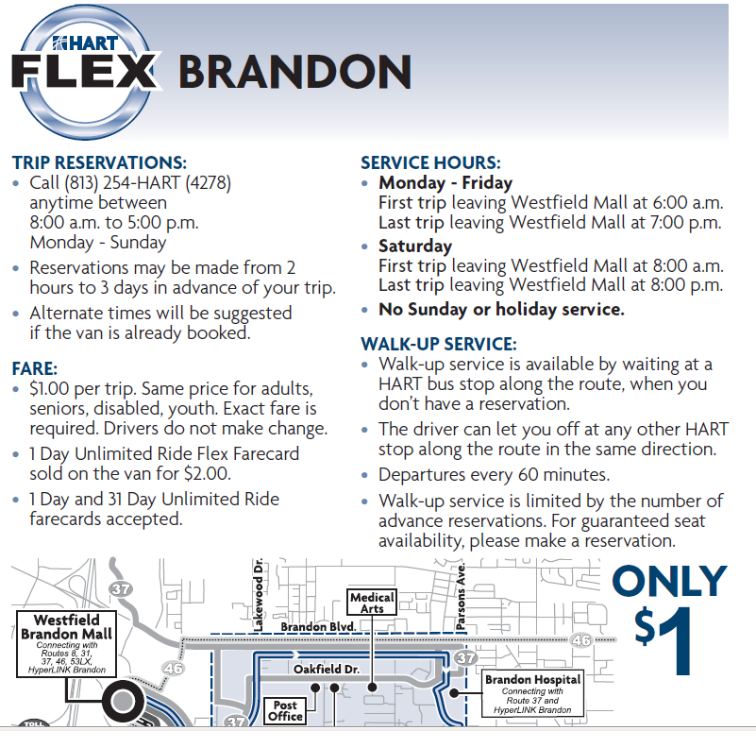
Flex Route and
Route Deviation Service
All ADA rules apply to this type of service
Additional complementary paratransit not required
A hybrid service that combines fixed route and paratransit by operating on a set course, but has the ability to go off route and provide door to door or curb to curb service.

Slide 20

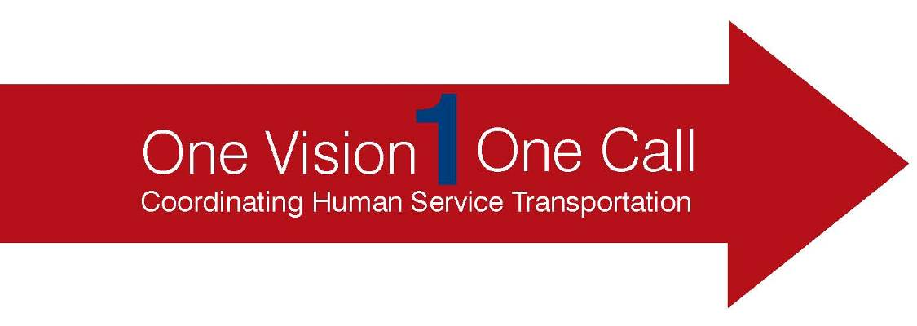
Coordinated System
Collaboration of various transportation providers, local officials, and those working for customer interests to collectively use limited resources to provide transportation
Example:
  United We Ride
    One-Call initiative
      Coordinate complete trip with one call to life sustaining and recreational activities
  Florida’s Transportation Disadvantaged Program
    CTCs direct and coordinated system services

Slide 21
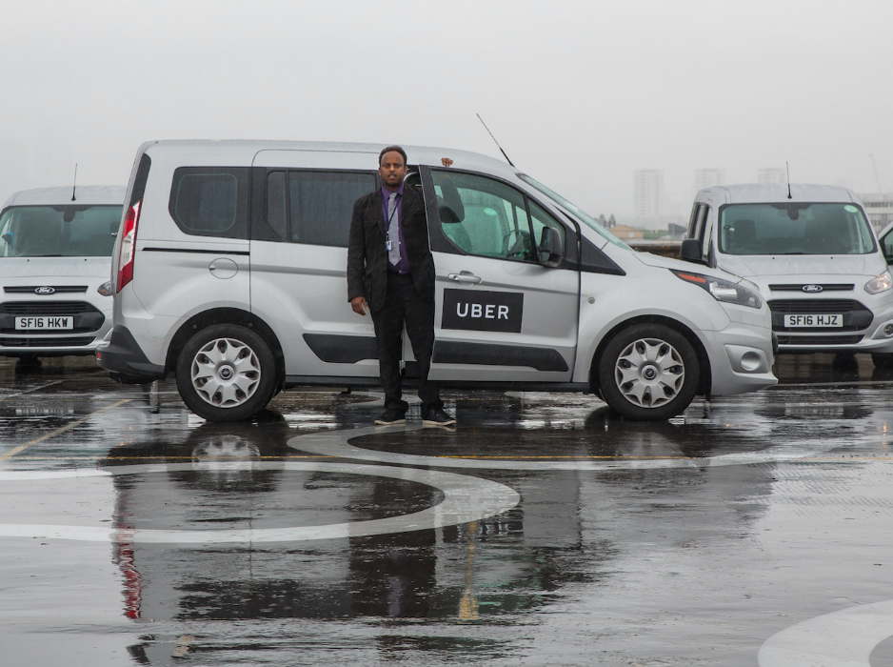
Transportation Network Companies and
Accessible Service Integration
Transportation network companies (TNCs) or “ride sourcing,” use smartphone applications to connect drivers with passengers.
Provide a sufficient quantity of wheelchair-accessible vehicles as a condition of entering into an agreement with the transit agency
Entering into a separate agreement with another entity that is capable of providing accessible vehicles (or)
Relying on accessible vehicles that are already part of the paratransit fleet
Provide the same level of service with
  Response time
  Fares
  Geographic area of service
  Hours and days of service
  Restrictions or priorities based on trip purpose
  Availability of information and reservations capability (and)
  Any constraints on capacity or service availability.

Slide 22
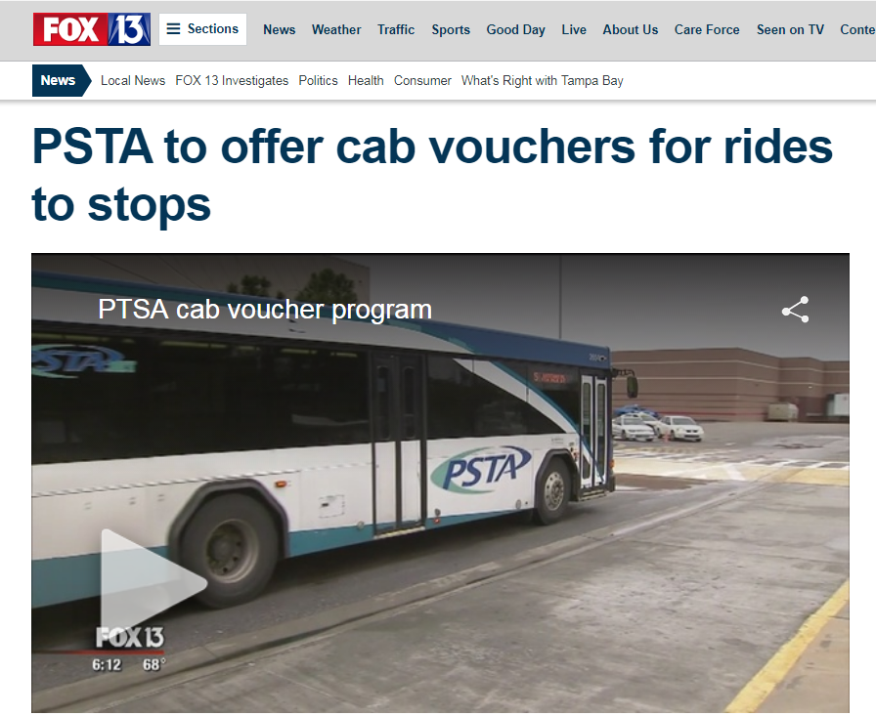
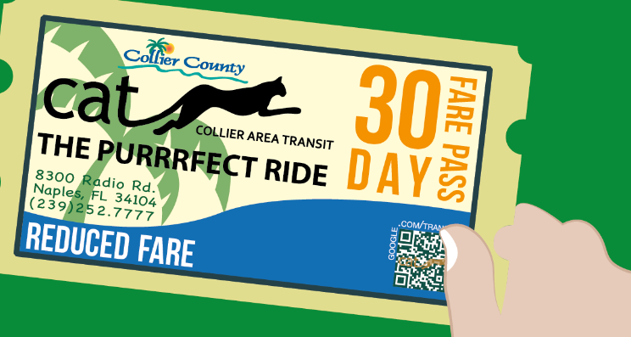
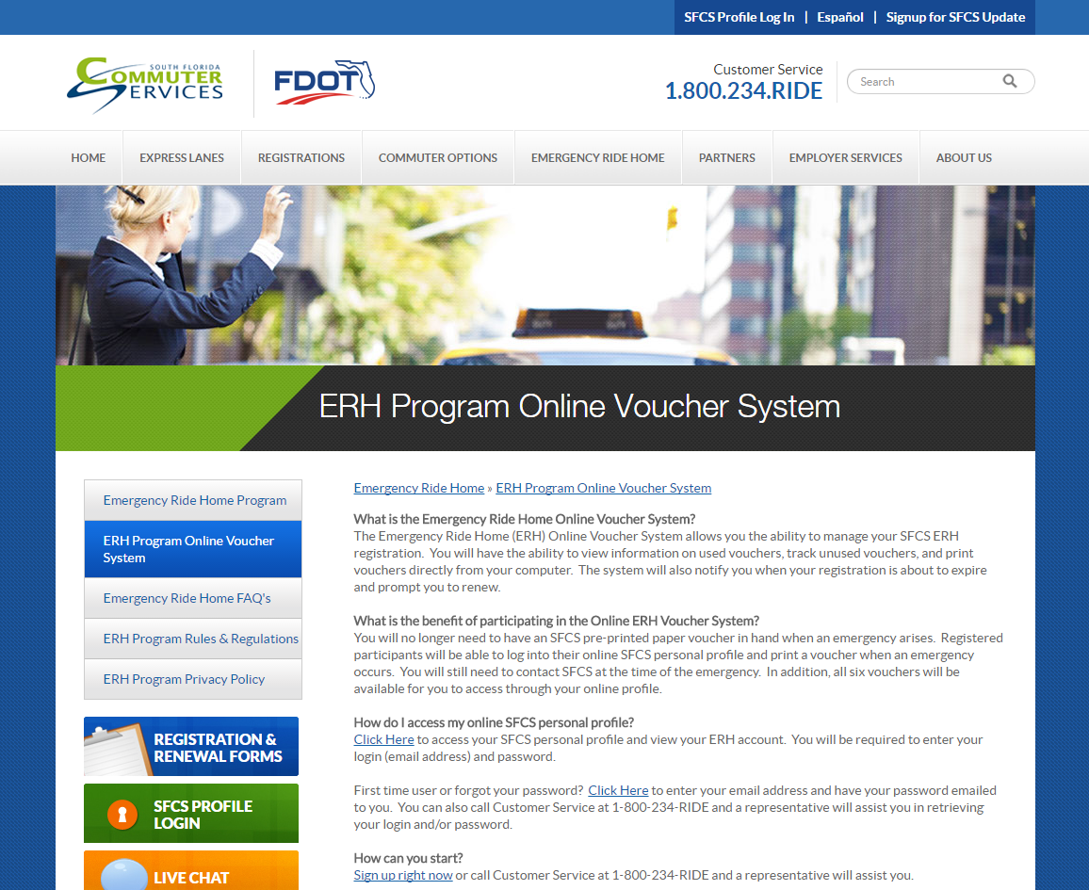
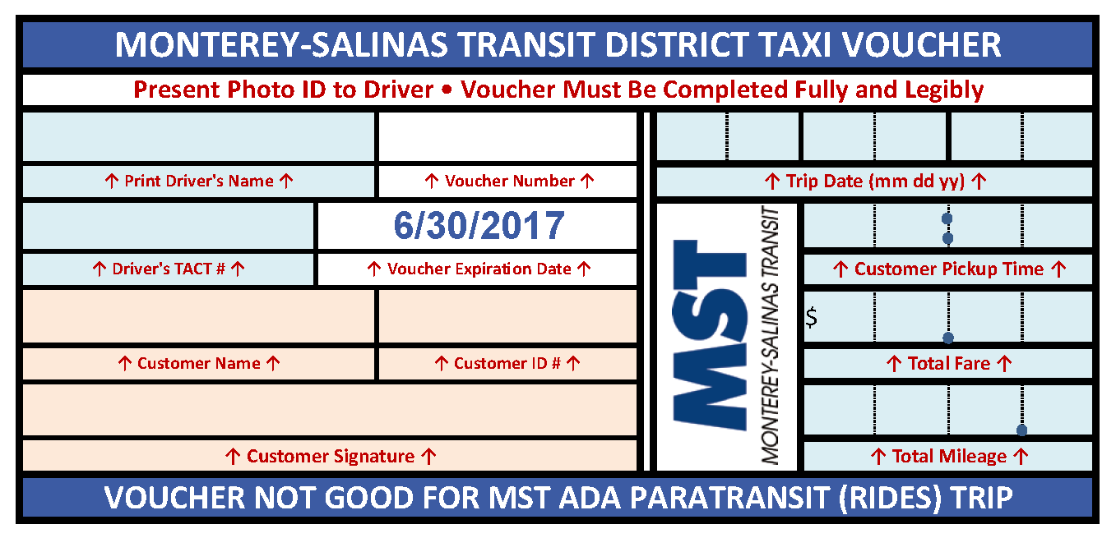
Voucher Service
A voucher system is a method of payment that enables people to obtain and afford transportation. Federal, state or local agencies that fund transportation develop a “purchase service agreement” with a voucher site or broker. The funding source reimburses the voucher site at an agreed-upon rate. Vouchers are an effective solution for the challenges of high cost and inadequate resources that impact many seniors, people with disabilities, and/or those with limited income who do not have a personal vehicle or the ability to drive..

Slide 23
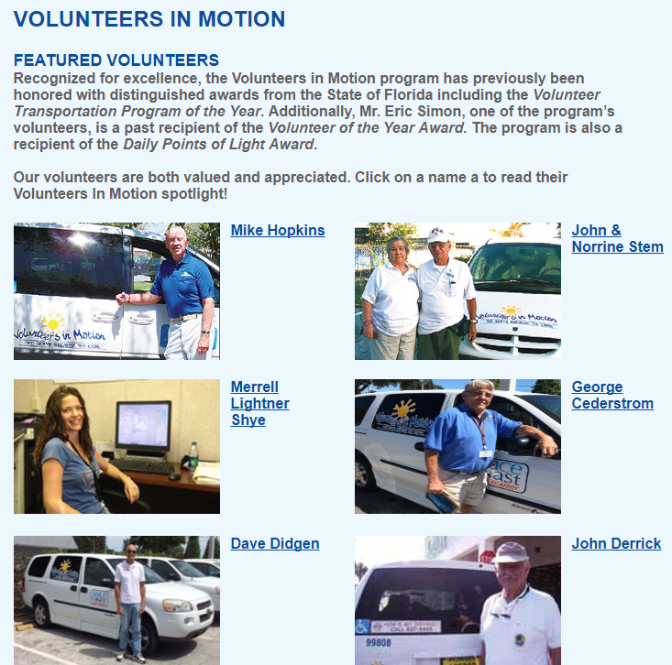

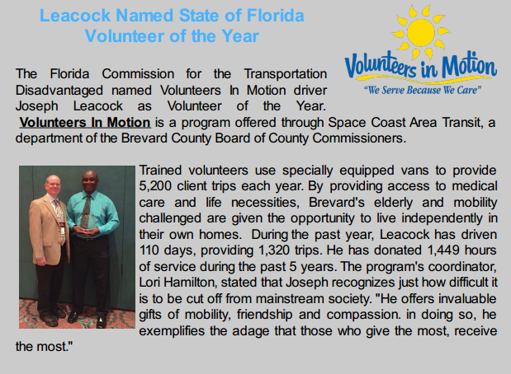
Volunteer Service Service
A volunteer service is where the passenger has the opportunity to recruit their own driver, who is then reimbursed for transporting the person
Example
  Ride to Care
    Facilitated through FamilyCare and Health Share of Oregon
    Eligible persons are reimbursed for driving or recruiting driver
    Managed by Access2Care

Slide 24
Transportation System Networks
Overview of transportation systems available for Persons with Disabilities throughout the State of Florida
Martin Catala

Slide 25
Public Transportation Operating Environment
Urban and Rural Communities
Demographic Trends
TD Populations

Slide 26
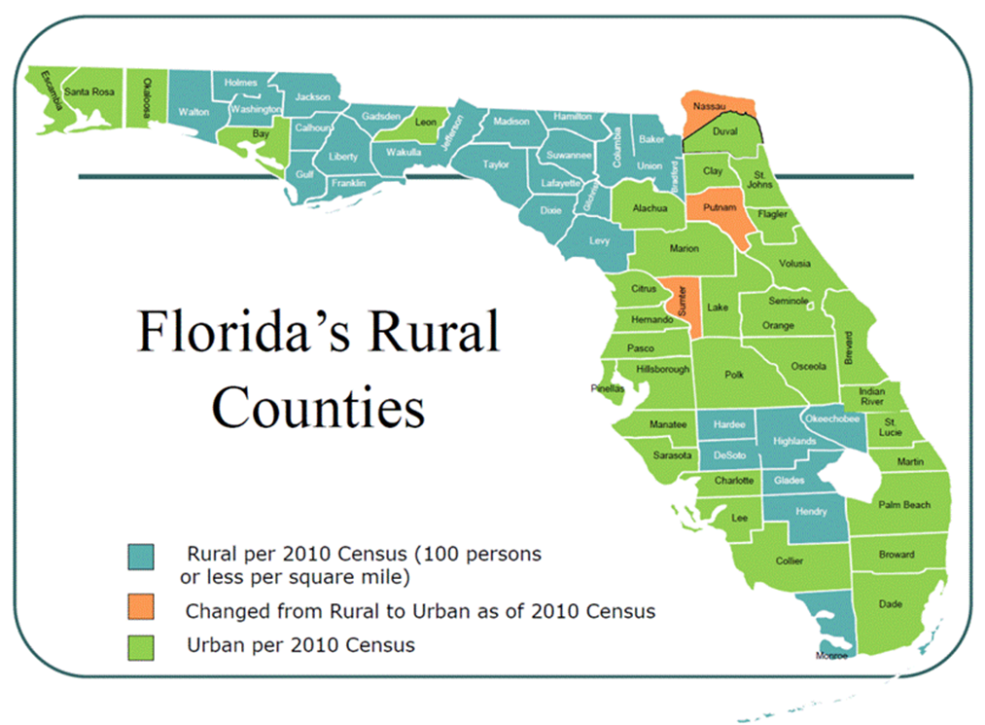
Urban / Rural Counties

Slide 27
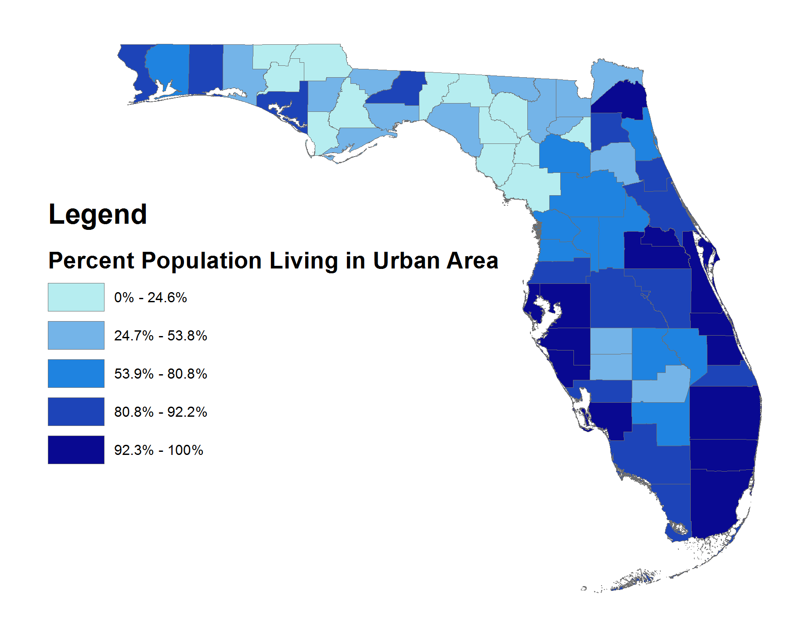
Urban / Rural Demographics
2014 Urban Population Estimate*
16.1 Million
2014 Total Population**
19.9 Million
*Based on 2014 ACS Census Block group Population Estimates
**Based on 2014 ACS Census Statewide Estimate

Slide 28
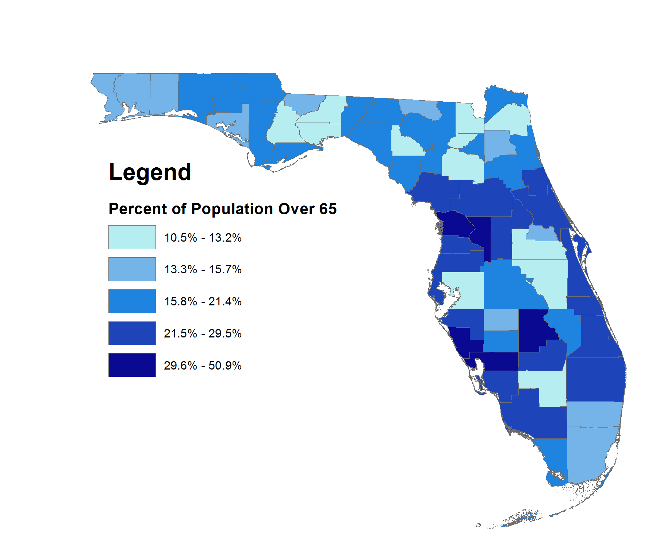
Senior Population
Statewide Population Over 65:
3,650,681 (2015)
5,893,435 (2030)
81% Urban Areas
19% Rural Areas

Slide 29
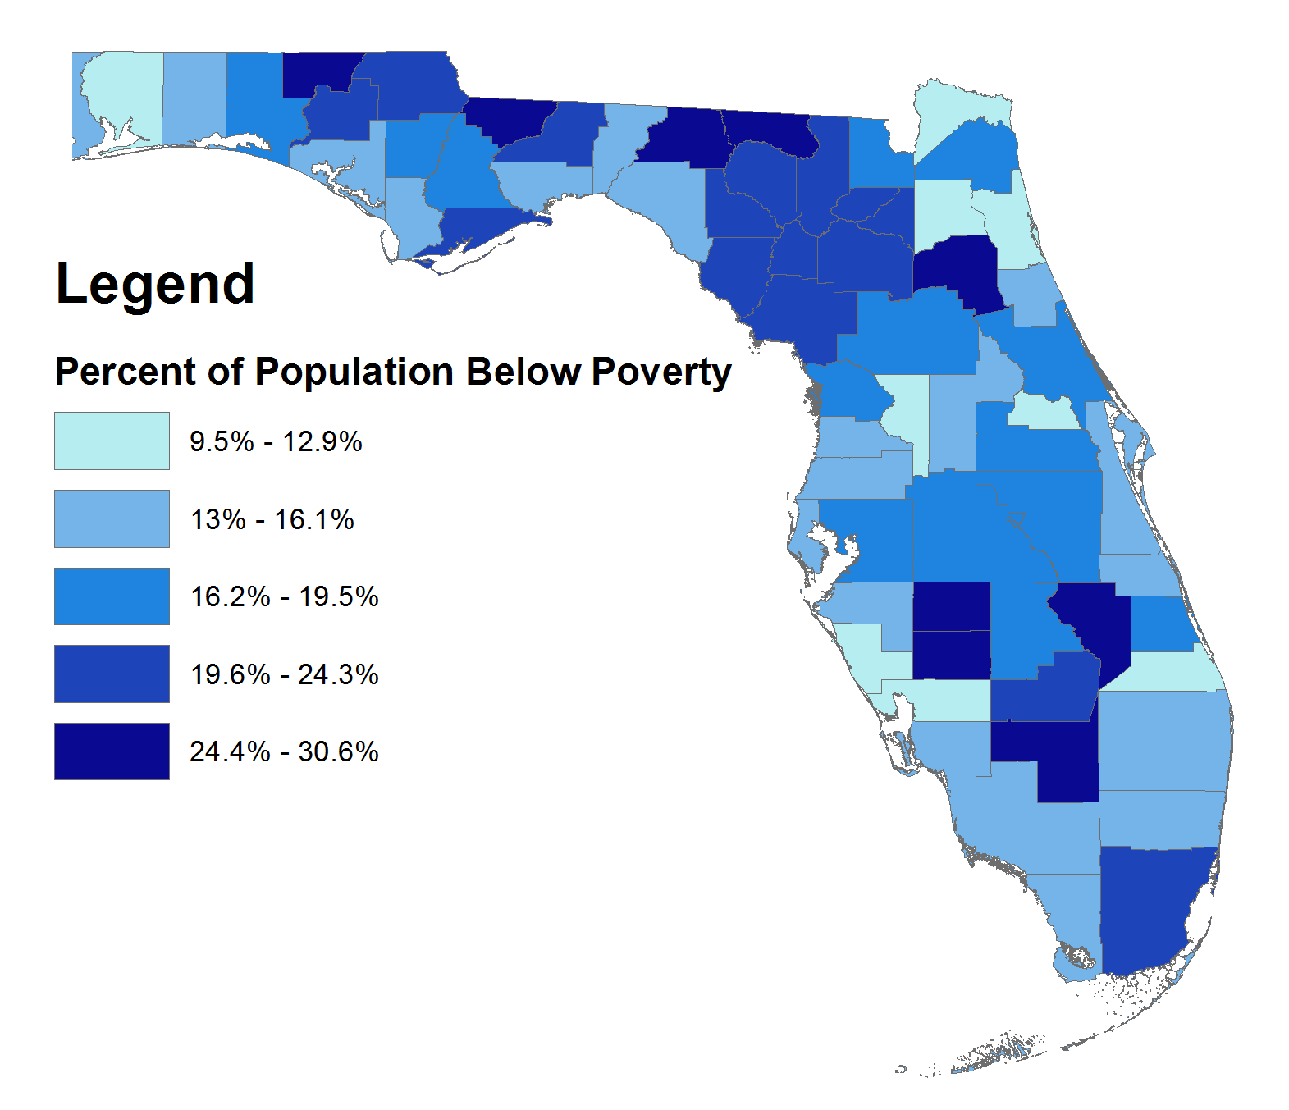
Population Below Poverty Level
Statewide Population Living Below Poverty Line: 3,180,109
83% Urban Areas
17% Rural Areas

Slide 30
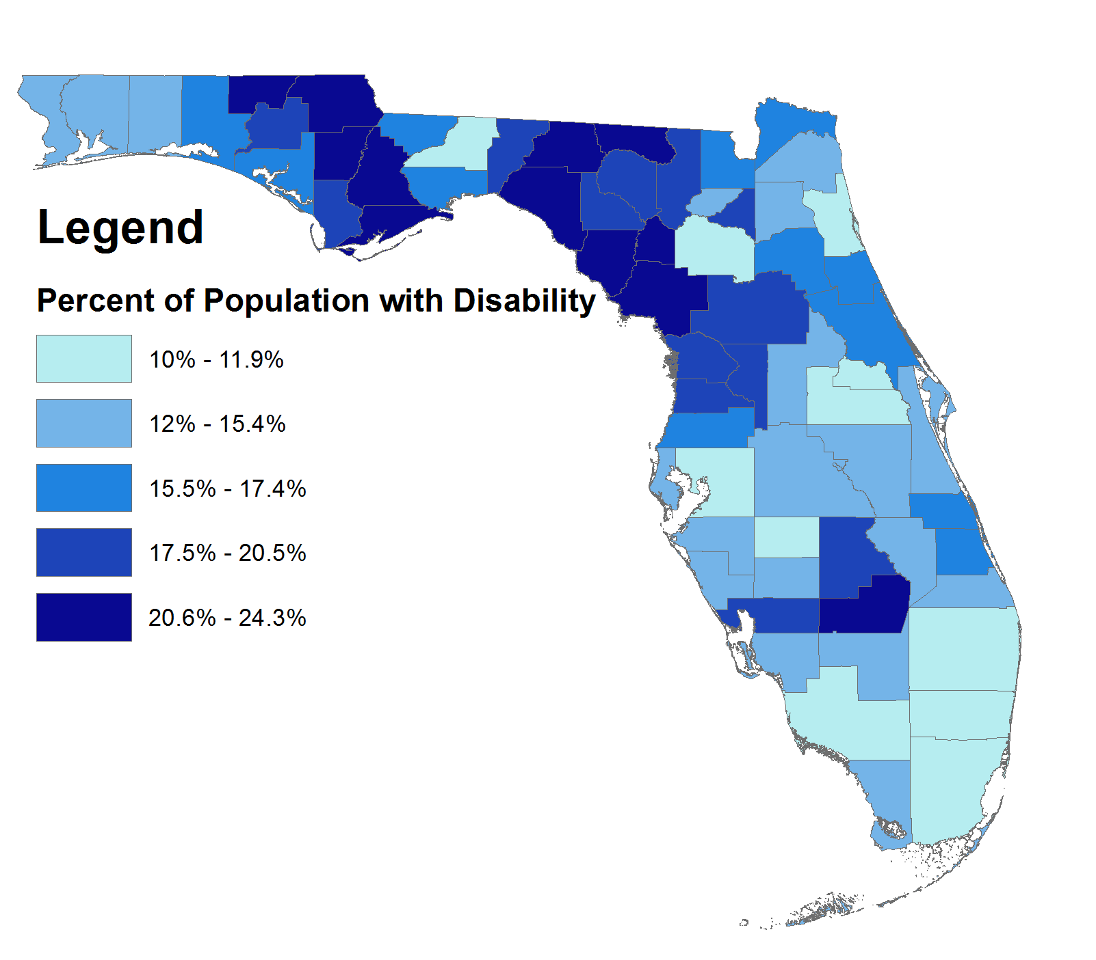
Disability Population
Statewide Disability Population: 2,553,636
79% Urban Areas
21% Rural Areas

Slide 31
Stratification of Existing Mobility Services
General Public Transportation Systems
Transportation Disadvantaged Program
Specialized Social and Health Services

Slide 32
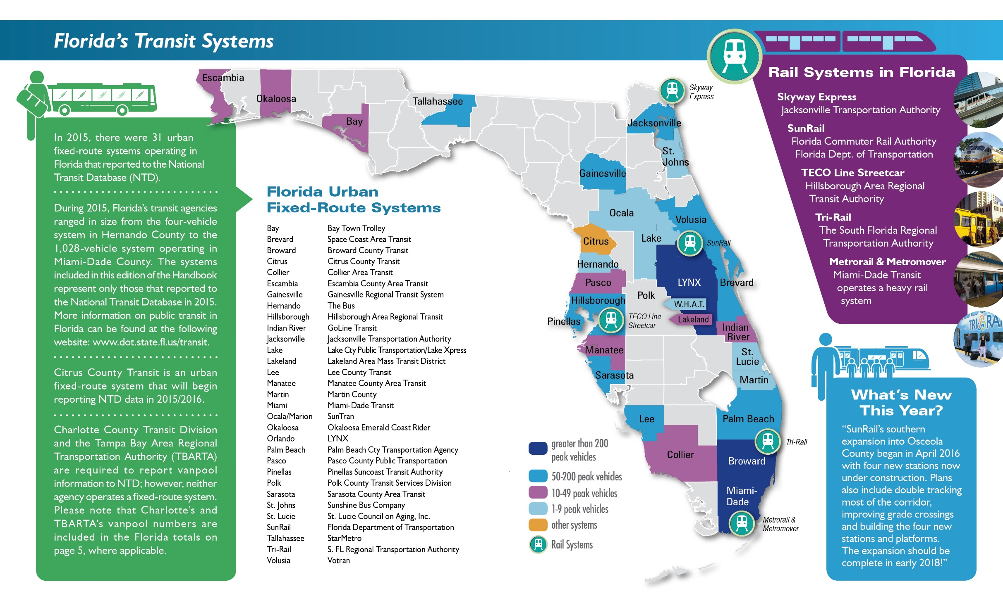
Urban Transit Systems

Slide 33
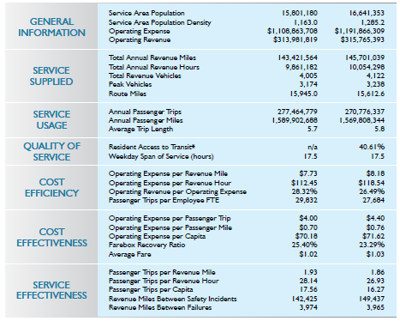
Urban Transit Systems
33 Urban Transit Systems
Annual Revenue Miles 143,421,564
Passenger Trips 277,464,779

Slide 34
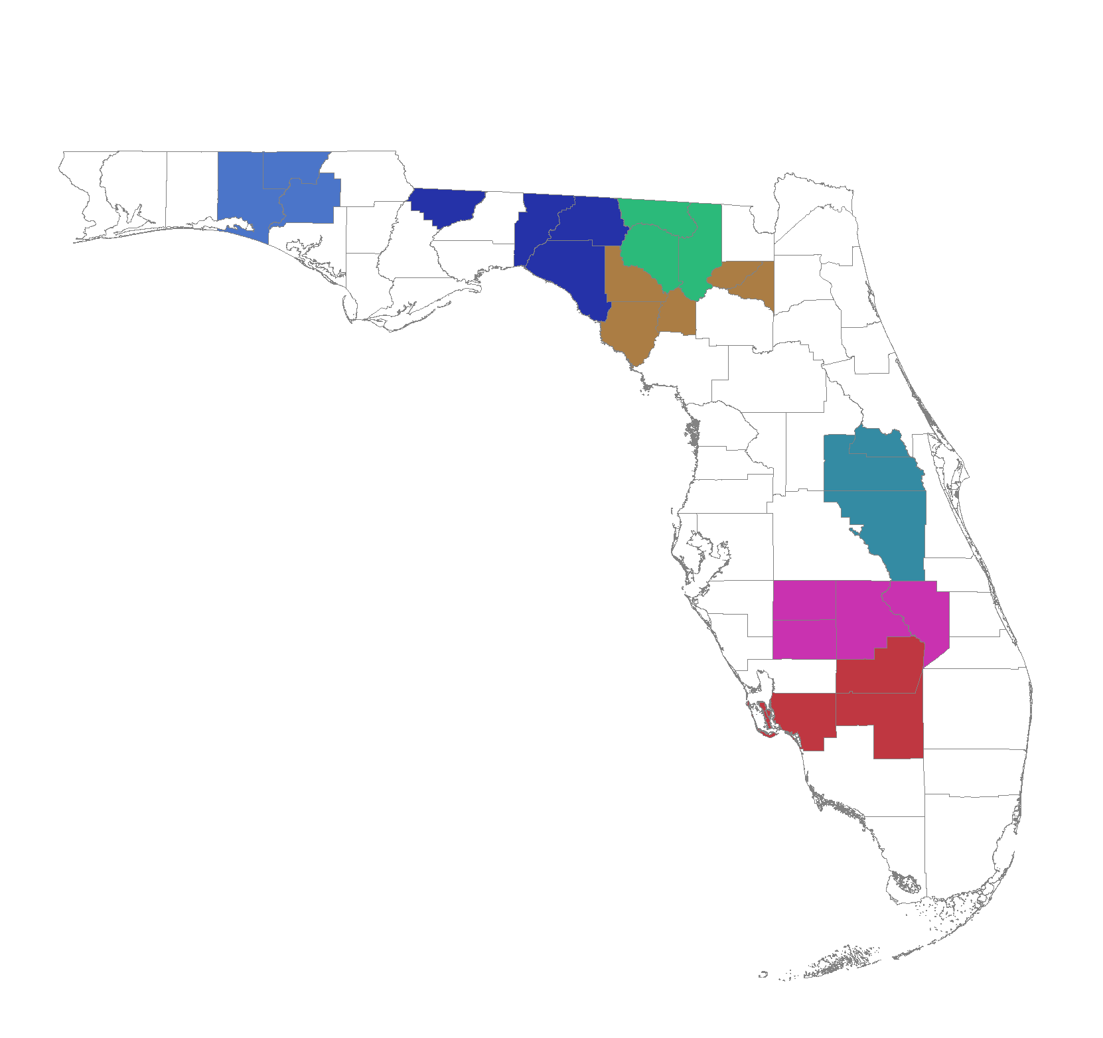
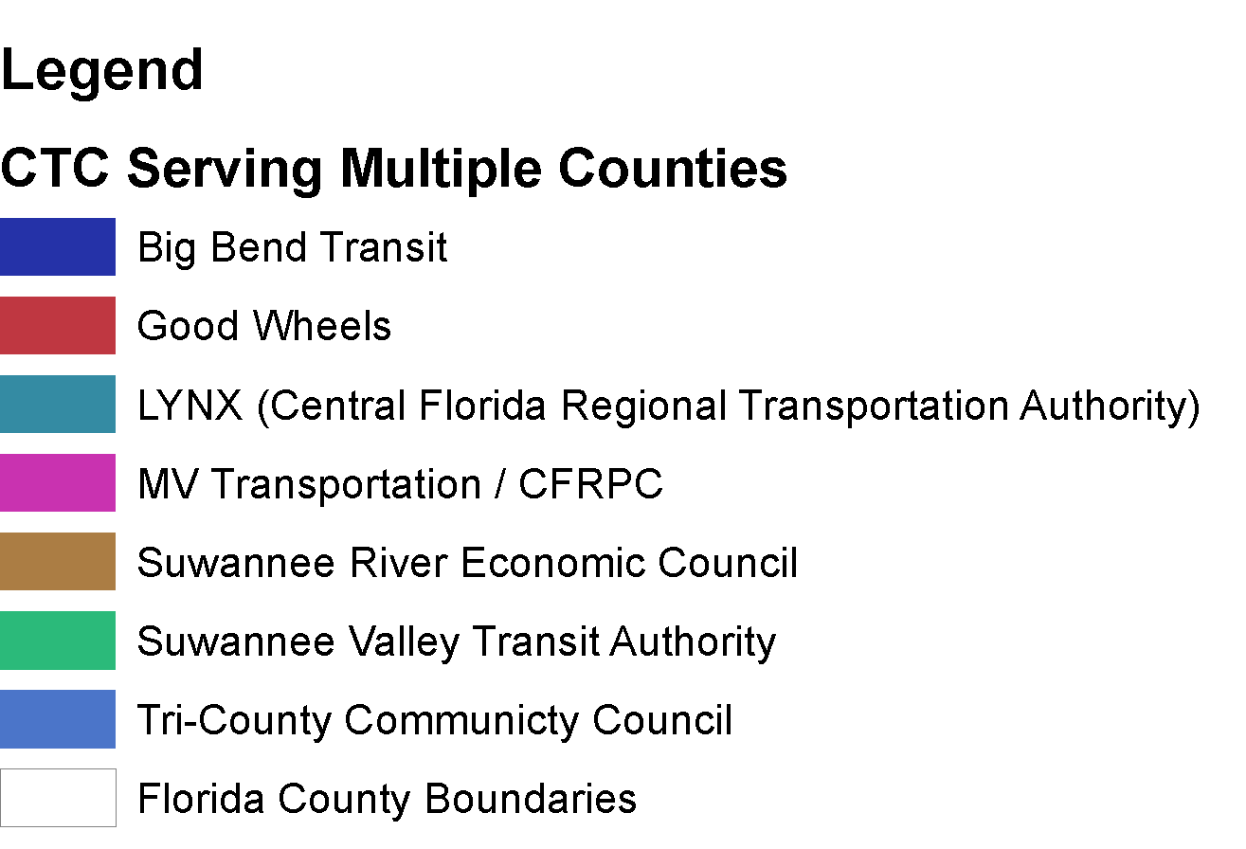
CTC Serving Multiple Counties

Slide 35
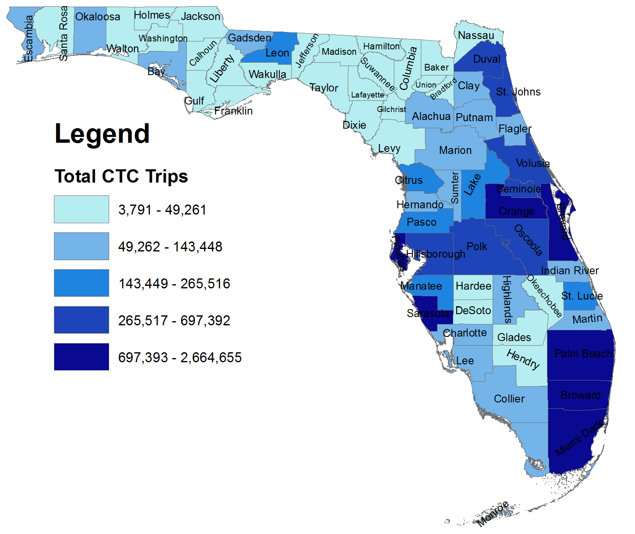
Total CTC Trips
Annual Total – 21 Million
52% Of Trips Fixed Route or Deviated Fixed Route
48% Trips – Paratransit Service

Slide 36
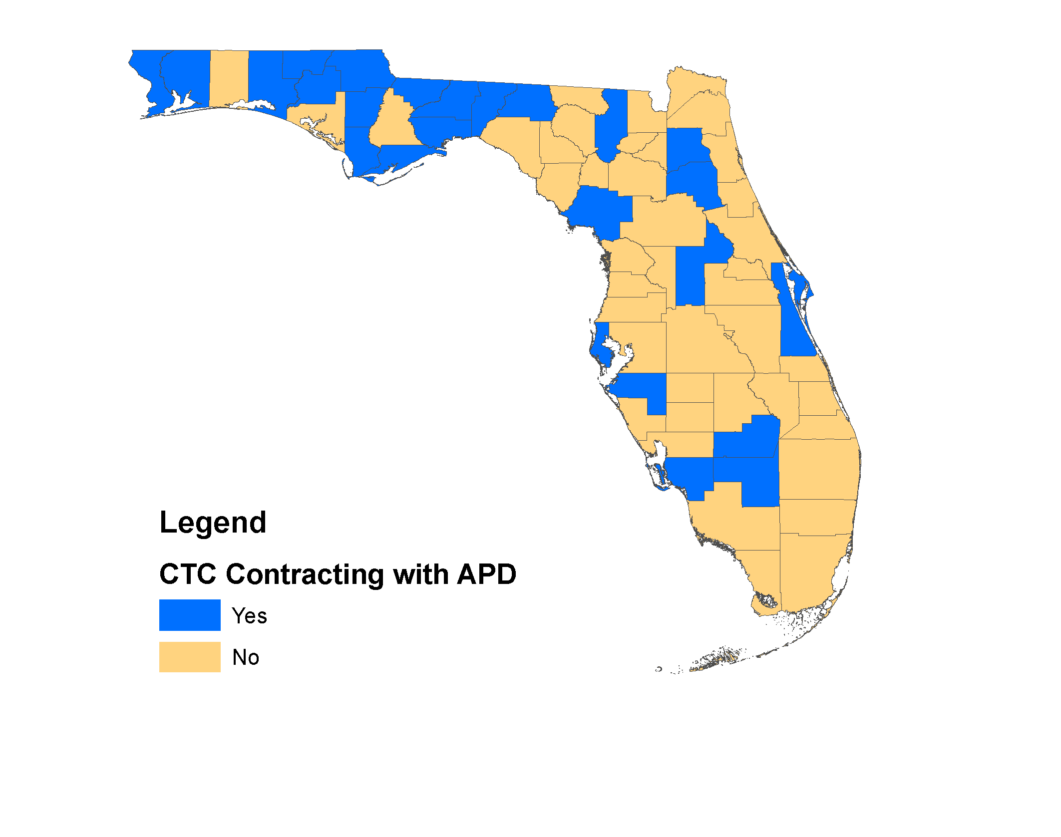
CTC Contracting with APD
CTC’s of Twenty-Five Counties Coordinate and Contract with APD

Slide 37
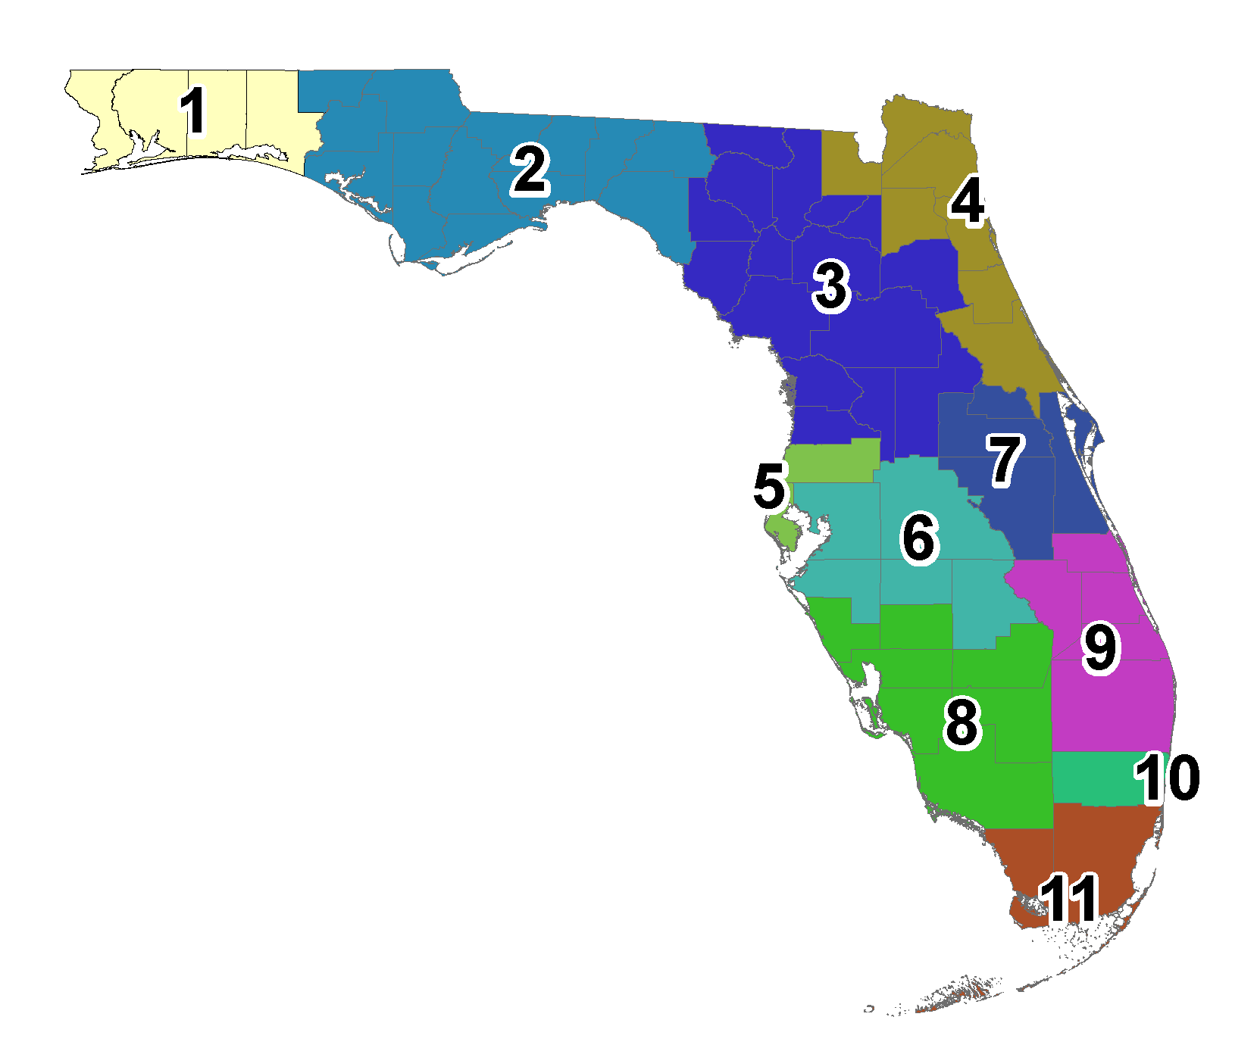
Medicaid Regions

Slide 38
NET Medicaid Regions and Providers
Serving Persons Not Under the Medicaid Managed Care Program
Two NET Providers – LogistiCare or MTM

Slide 39
APD
Agency for Persons with Disabilities
Transportation System and Customers

Slide 40
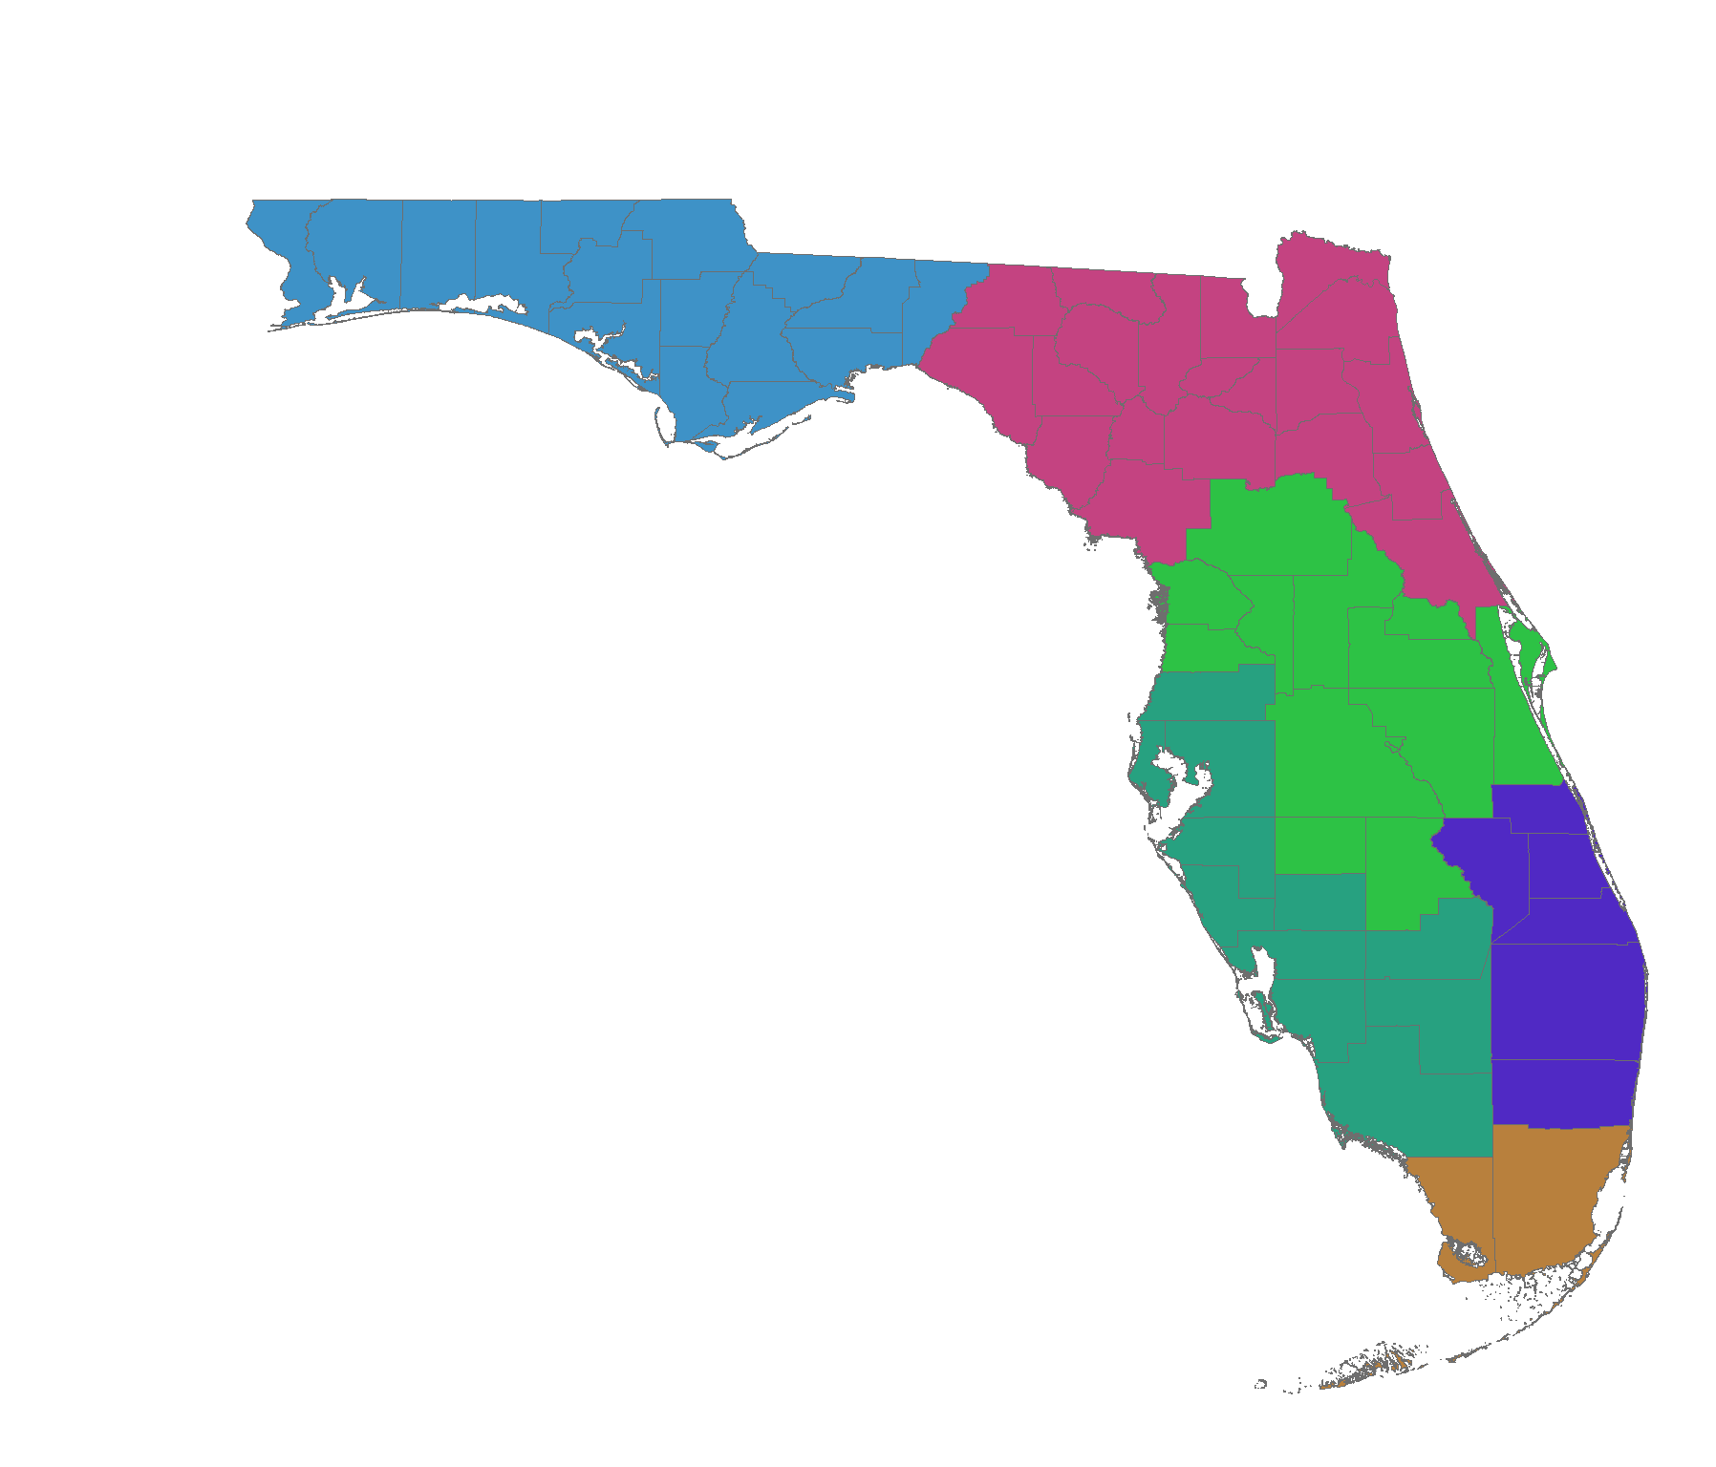
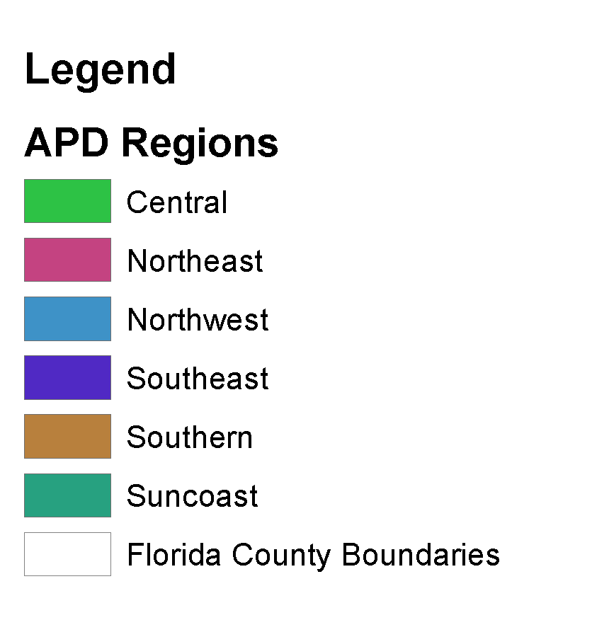
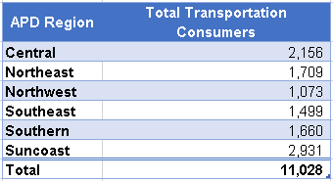
APD Regions

Slide 41
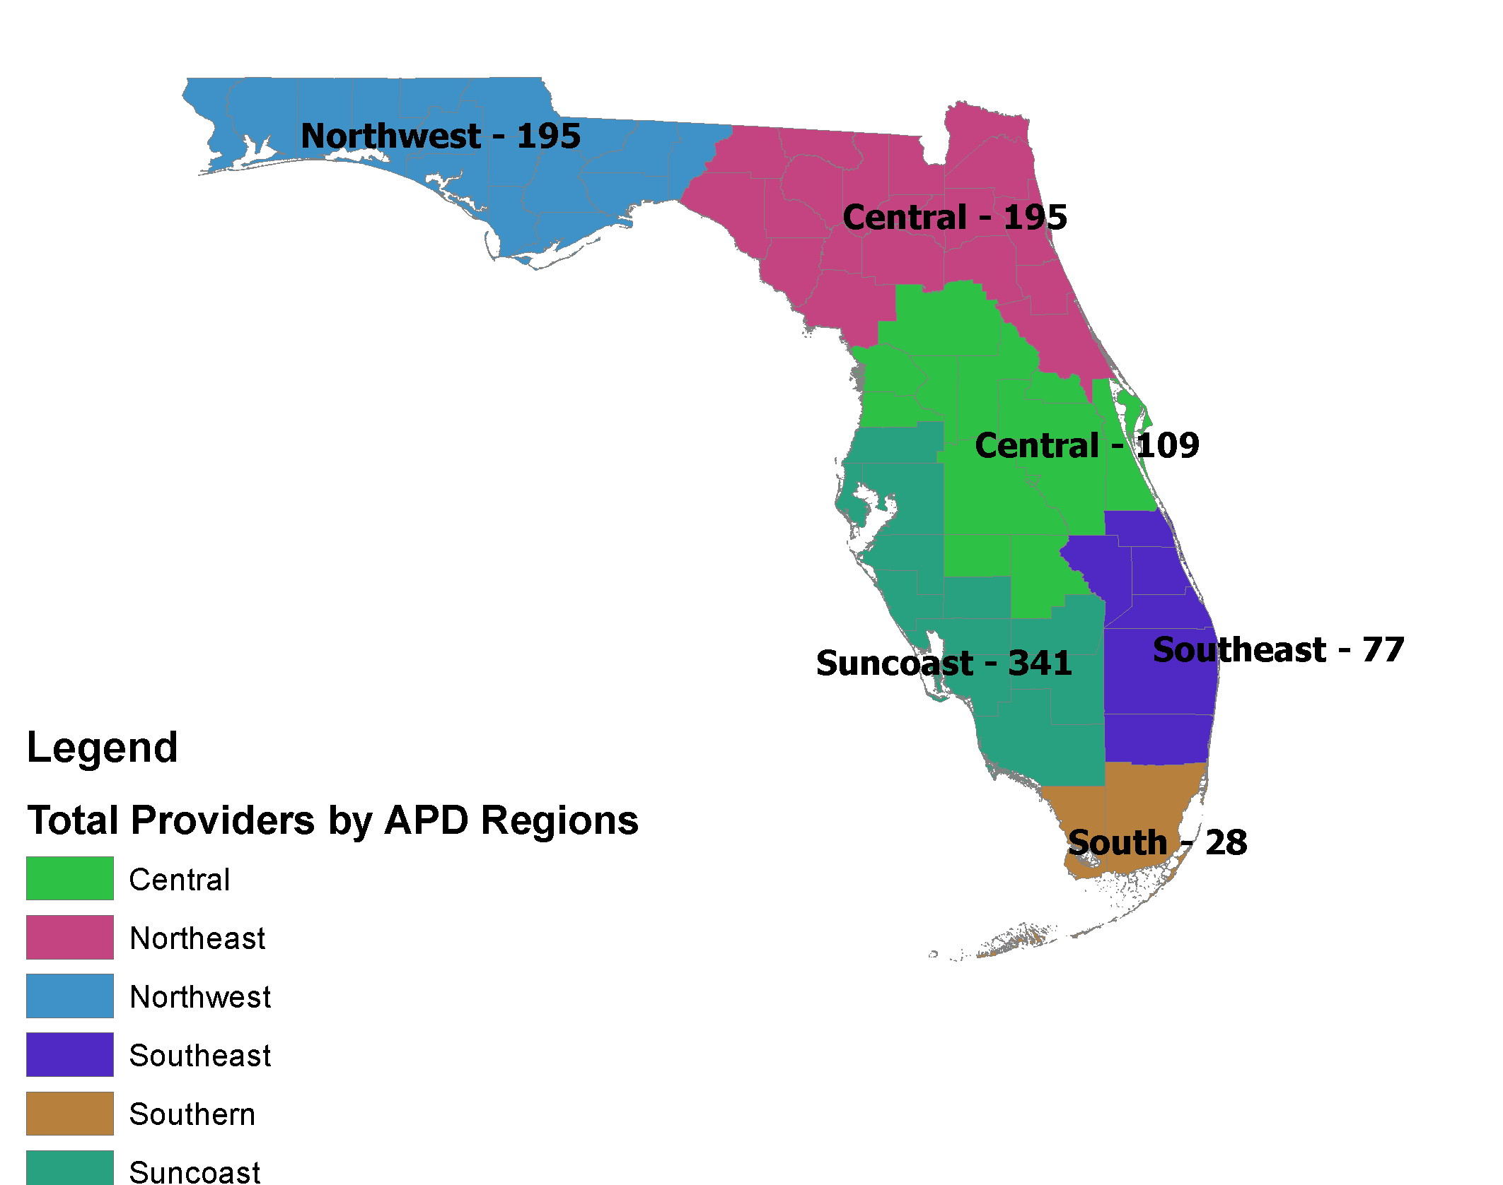
APD Transportation Providers
65 Different Types of Service
352 Unique Providers

Slide 42
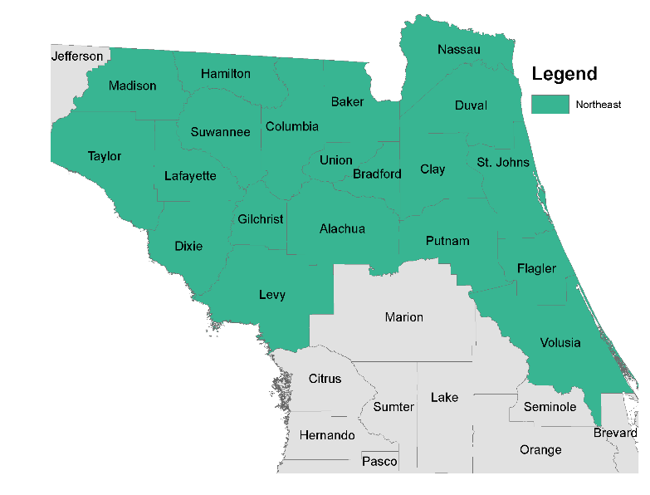
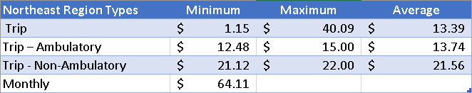
APD Region – Northeast
20 Counties
4 Service Categories

Slide 43
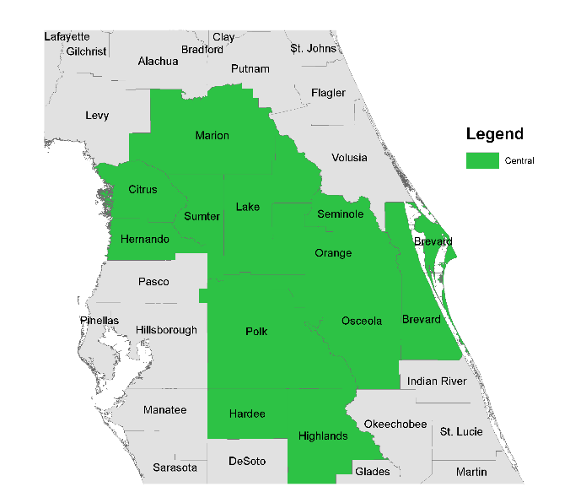
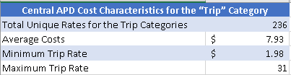
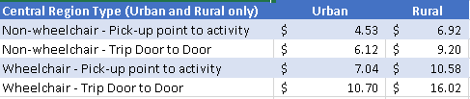
APD Region – Central
12 Counties
5 Service Categories

Slide 44
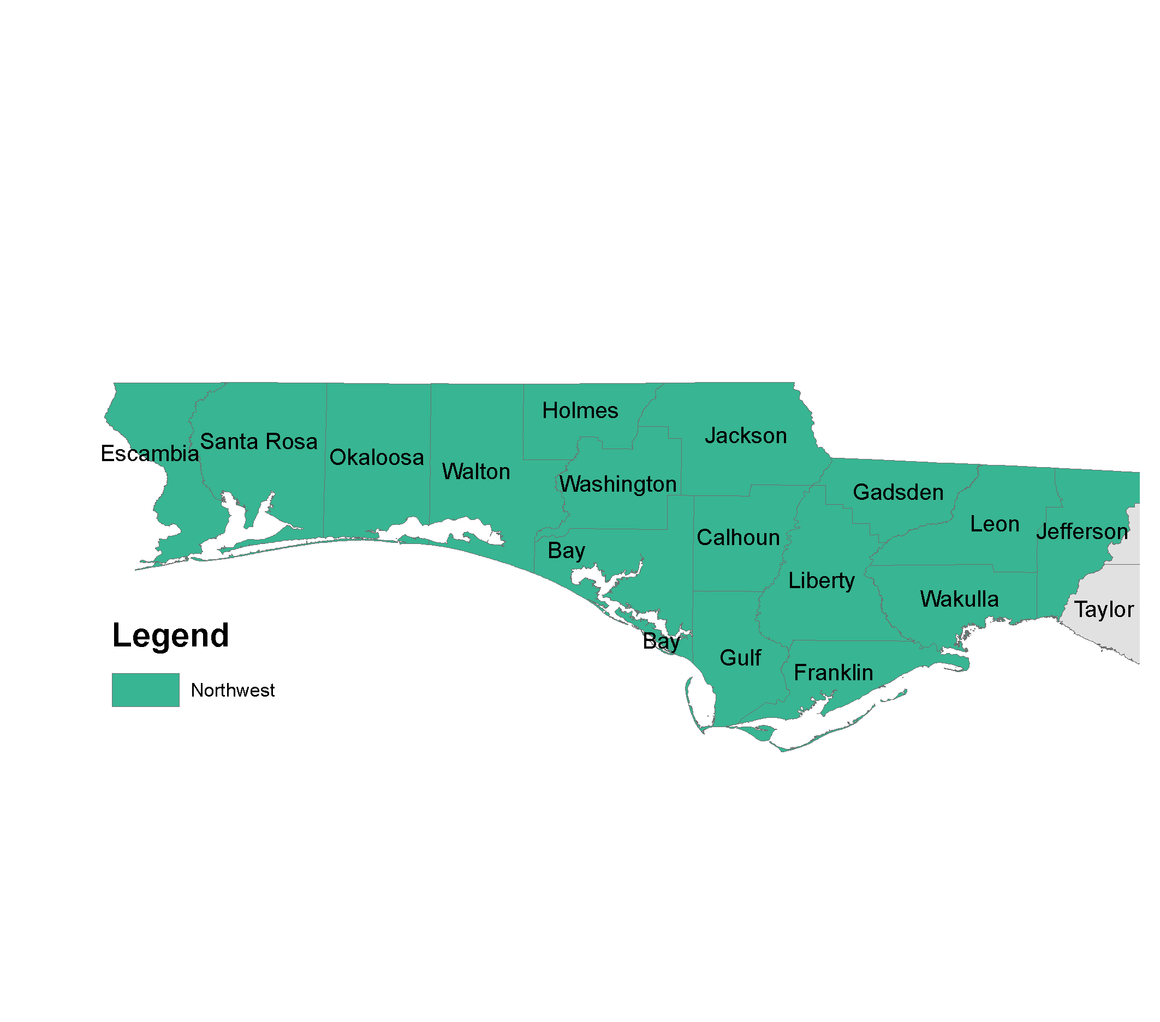
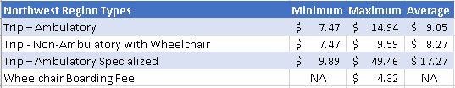
APD Region – Northwest
16 Counties
49 Separate Service Types

Slide 45
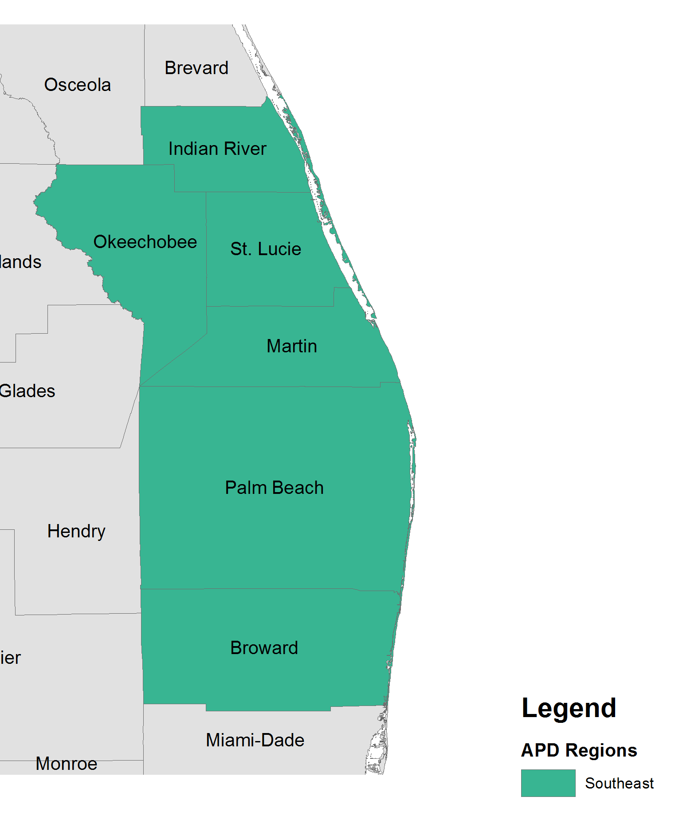

APD Region – Southeast
6 Counties
3 Service Categories

Slide 46
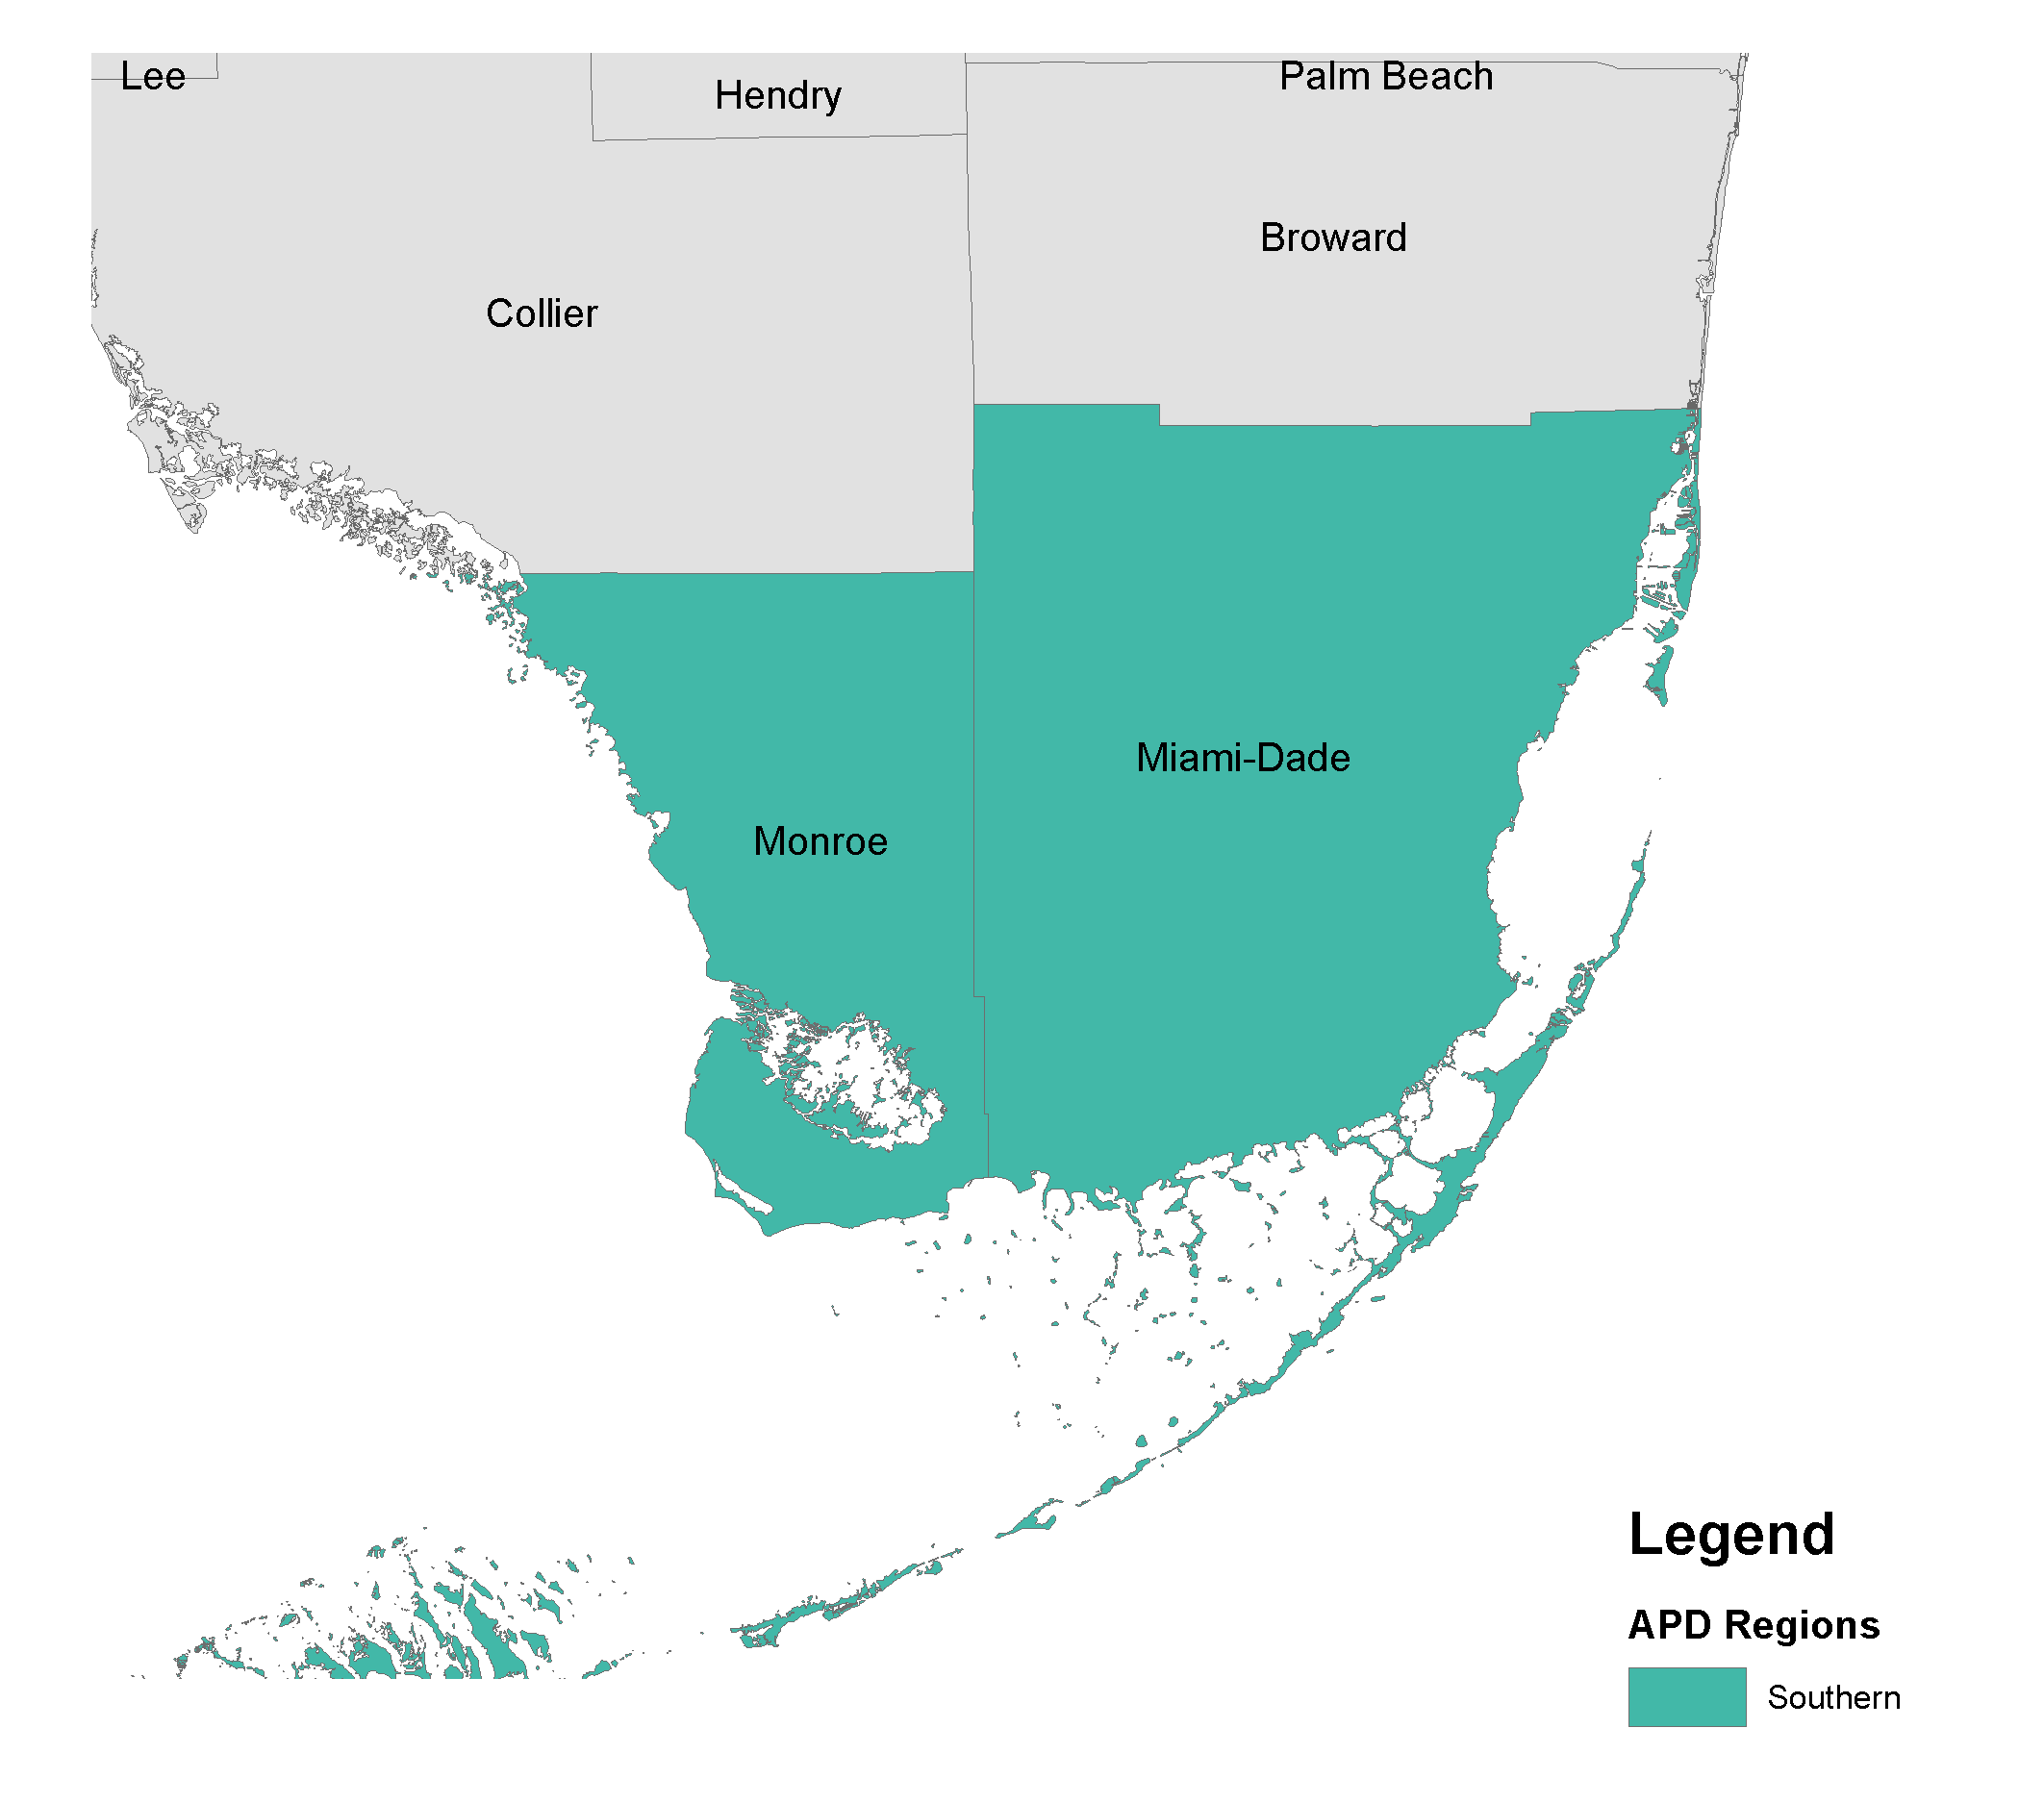

APD Region – Southern
2 Counties
3 Service Categories

Slide 47
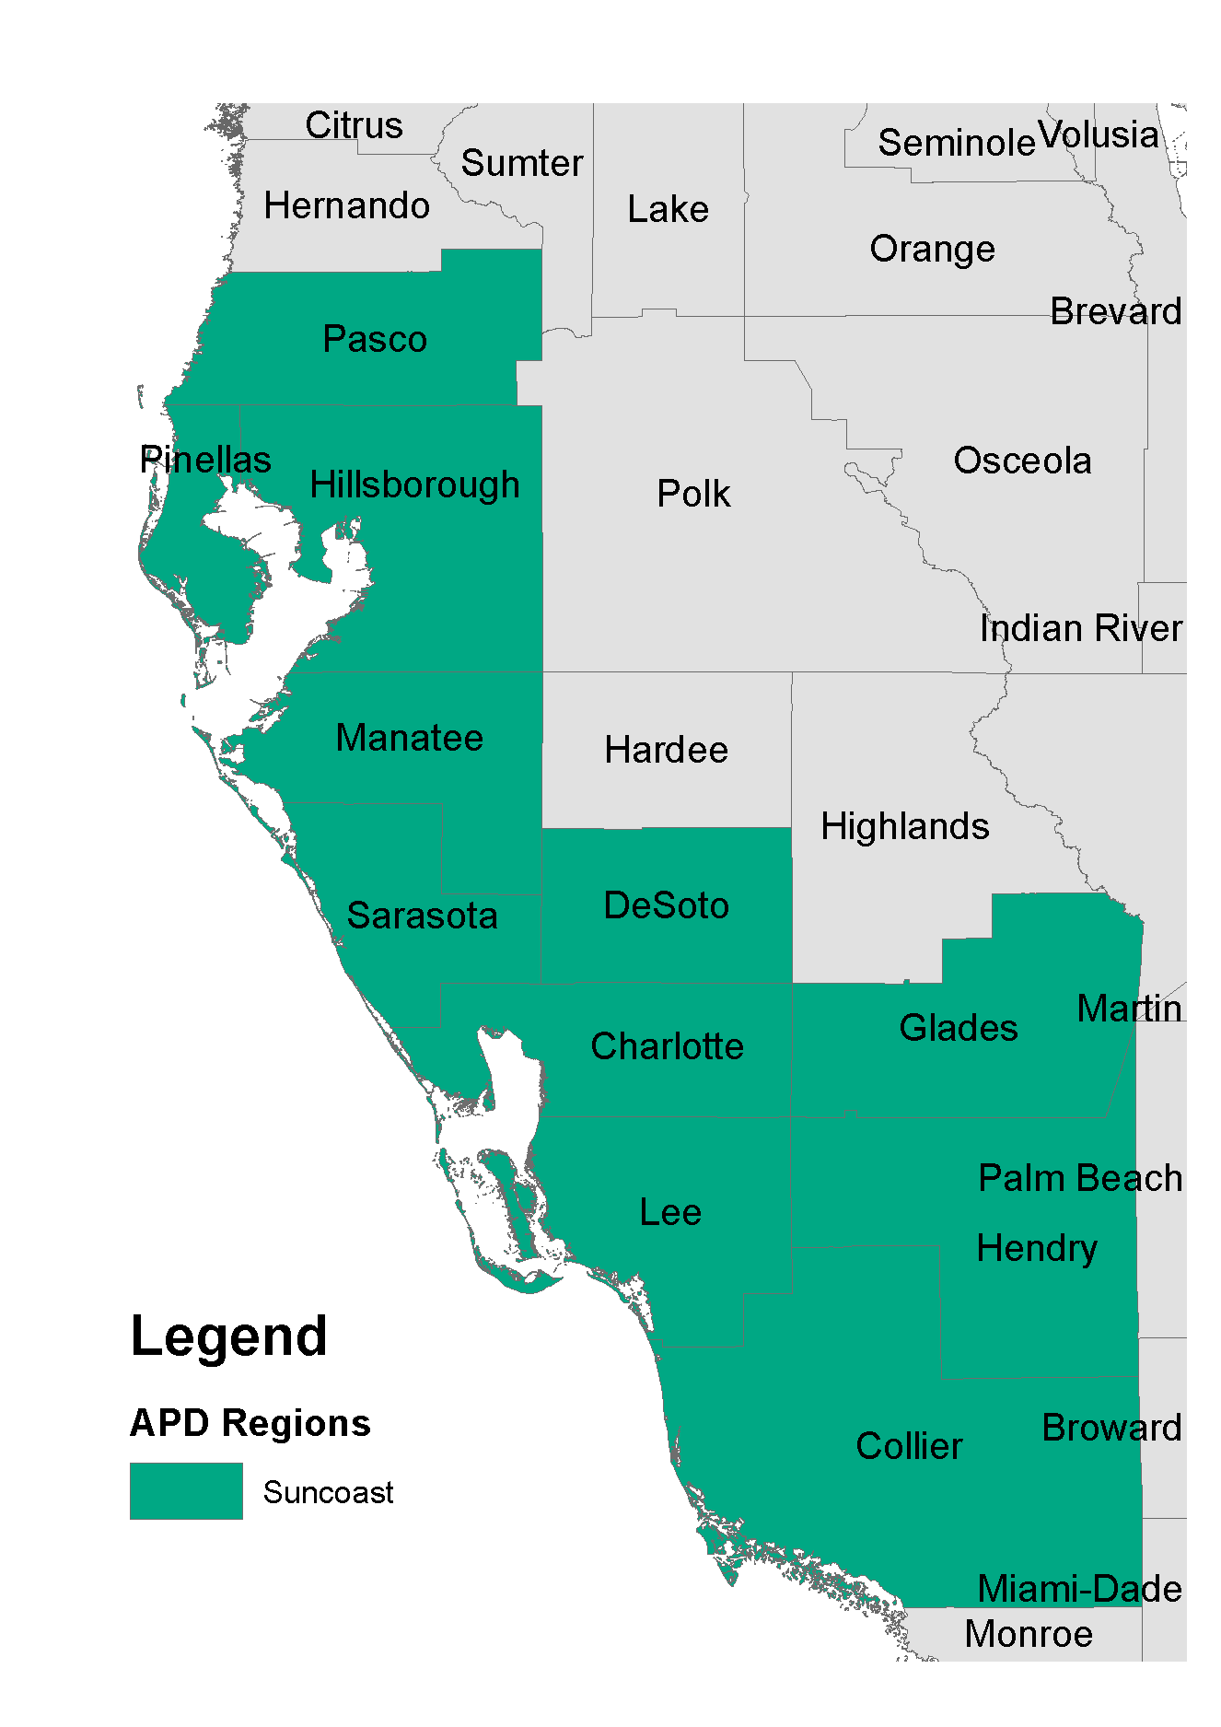
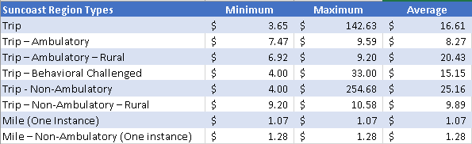
APD Region – Suncoast
11 Counties
8 Service Categories

Slide 48
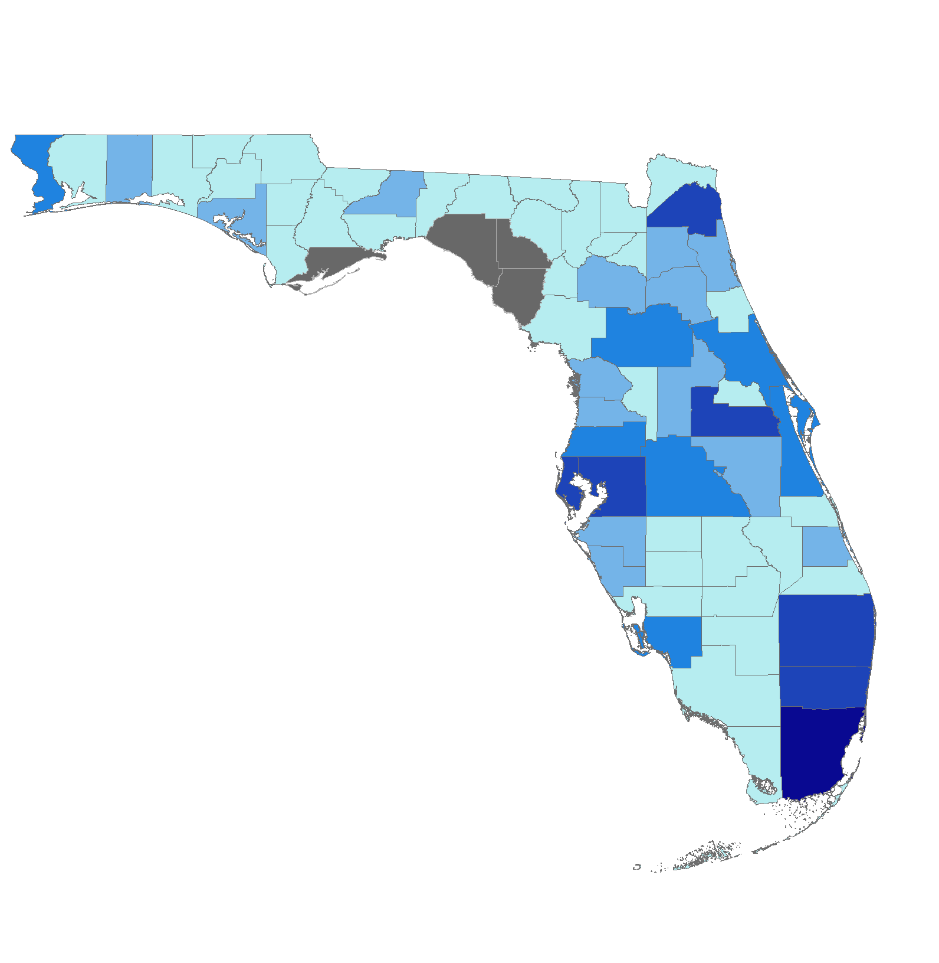
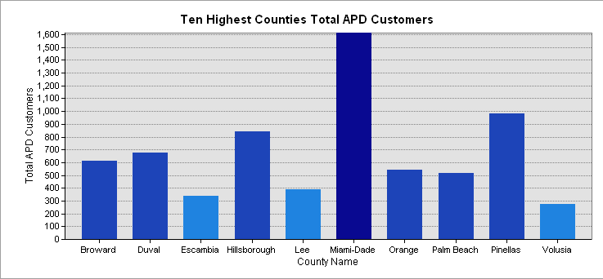
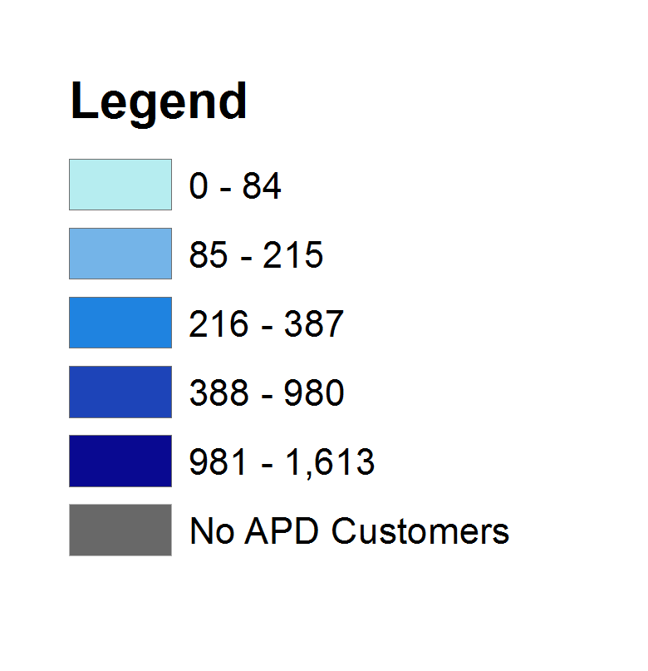
APD Transportation Customers

Slide 49
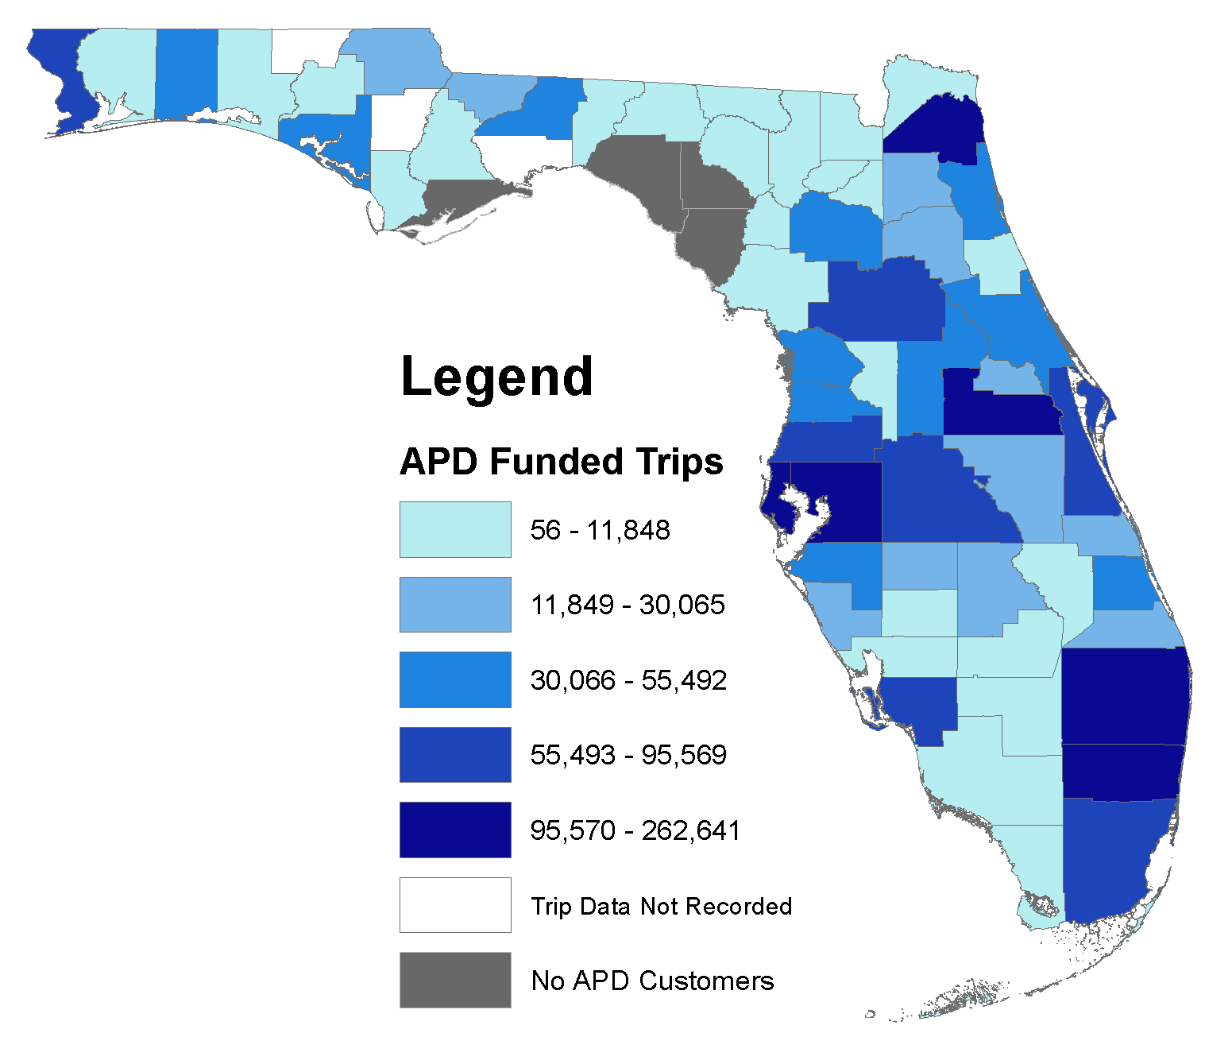
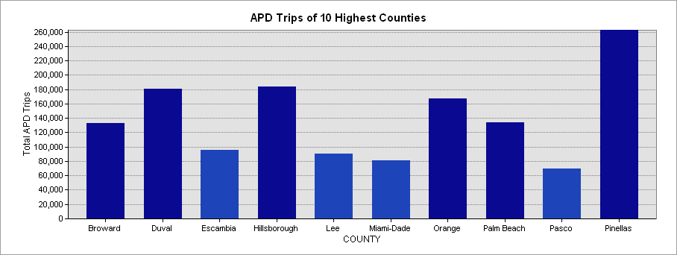
APD Funded Transportation Trips

Slide 50
Analysis of APD Process
Transit Service
Customer
Process for acquiring
Cost determination / negotiations
Provider Qualifications
Urban vs. Rural
Relationship with CTC
Coordinator Role / Responsibility
iBudget selection and choice of Transportation
Trip type eligibility

Slide 51
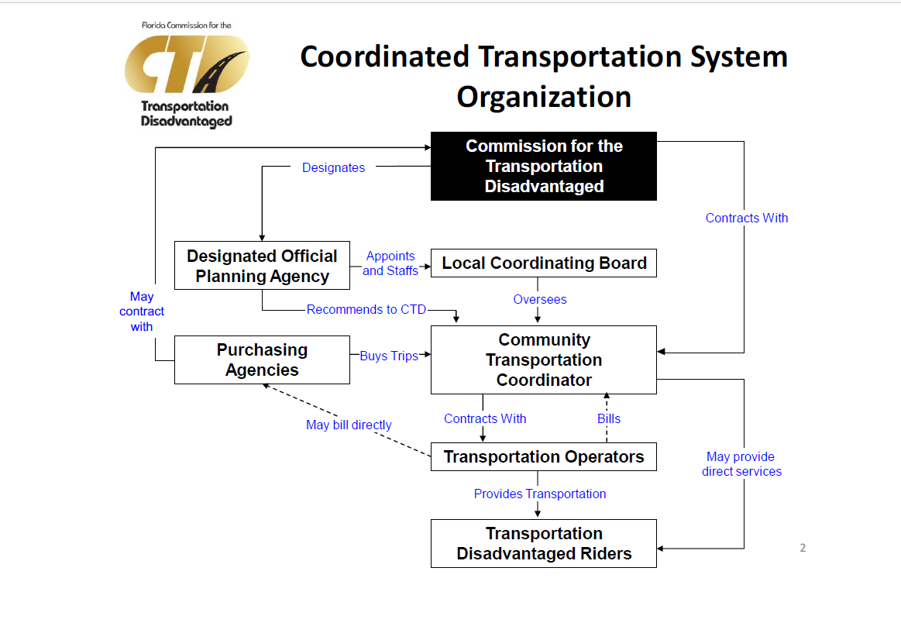
CTD Organizational Template

Slide 52
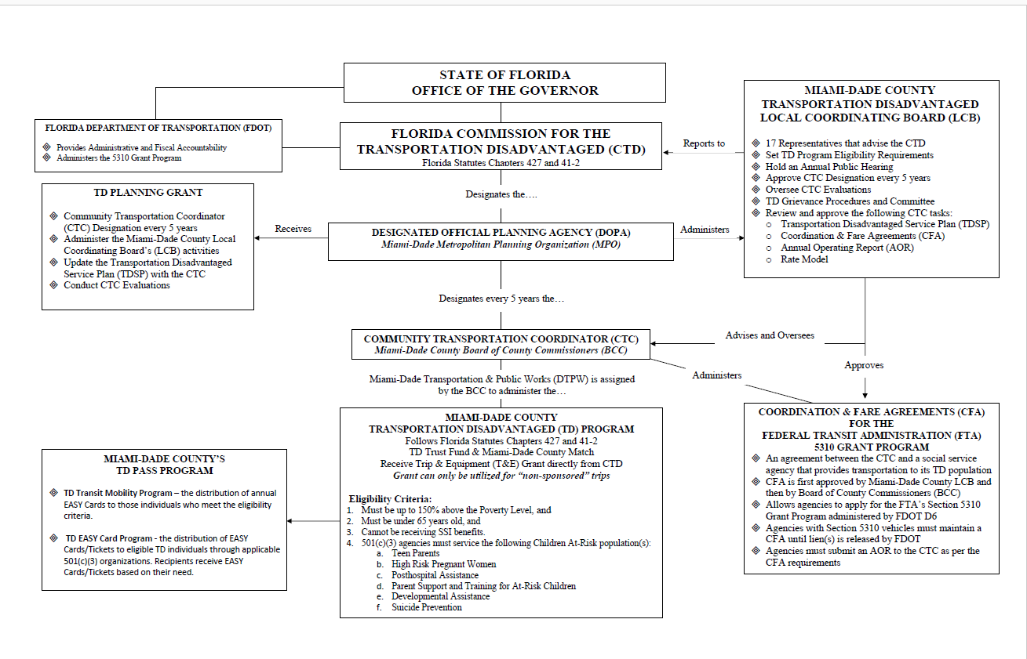
Connecting Dots: DTPW

Slide 53
Funding Programs
Specific Eligibilities

Slide 54

Program Coordination
Funding Source
Federal Health Programs / Medicaid
AHCA
APD
CTD
Federal Transit Administration
Urban 5307 / 5310
Rural 5311 / 5310
FDOT Transit
Florida State Programs
AHCA (NET)
Local

Slide 55






Funding Programs
FTA
  5307 Urban / General / ADA
  5310 Seniors / Persons w Disabilities
  5311 Rural / General / ADA
FDOT
  FTA Sub-recipients
  Service Development
  Contribute to TD
CTD
  Non Sponsored
  Seniors / Low Income / Persons w Disabilities
Local
  Public Transit Agencies / CTC’s
  Match FTA / FDOT / CTD
  Human Service Agencies Support
  Special Districts

Slide 56

Section 5310 Purpose
To improve the mobility of seniors and individuals with disabilities where public transit services are unavailable or insufficient.

Slide 57
Program Administration
Administration is provided for 3 distinct areas:
  Large urbanized areas (200,000 population or greater)
  Small urbanized areas (50,000-199,999 population)
  Rural (under 50,000 population)
The FDOT is the designated recipient for small urbanized and rural areas.
Most large urbanized areas have also selected FDOT to administer the program for their urbanized area.

Slide 58
Sec 5310 Eligibility
Community Transportation Coordinators (CTCs), both public and private non-profit
Private non-profit organizations under a coordination agreement with a CTC
States or localities that provide transit service
Private taxi companies that offer shared-ride services to the general public
Taxi companies that provide only exclusive-ride service may participate in the Section 5310 program as contractors only

Slide 59
Issues, Barriers, Service Gaps
Study Objectives
Task Force Input
Analysis & Discovery

Slide 60
Sorting Issues
Environment
Urban vs Rural
Service Area Coverage / Inter-County / Regional Connections
Operations
Service Type
Contracting
Fare Systems
Fares
Media
Access
Local Traffic Conditions
Identification
Routing
Frequency
Equipment

Slide 61
Sorting Issues
Customer Experience
Eligibility
Communication
Coordination
Service Type
Contracting
Policy
Fares
Media
Access
Awareness
Travel Time
Regional
Trip Purpose
Pick-Up / Drop Off
Travel Time
Programs
Inter-Agency
Community Services
Eligibilities
Compliance
Civil Rights

Slide 62
Sorting Issues
Funding
Eligibility
Compliance Requirements
Management
Budget
Contracting
Customer Care
Driver Training
Sensitivity and Etiquette
Access
Awareness
Efficiency
Customer Service
Mobility Management
Seamless travel
Empathy
Communication

Slide 63

Reflection
Issues and Barriers
Service Coordination / Customer Experience

Slide 64
Key Studies and References
Jay Goodwill

Slide 65
Topical Studies and Research (detailed in Progress Report)
TCRP REPORT 163: Strategy Guide to Enable and Promote the Use of Fixed-Route Transit by People with Disabilities
  TRANSPORTATION RESEARCH BOARD, WASHINGTON, D.C. 2013
Innovative Approaches for Increasing Transportation Options for People with Disabilities in Florida
  FLORIDA DEVELOPMENTAL DISABILTIES COUNCIL, INC., APRIL 2010
  By: USF Center for Urban Transportation Research
Forecasting Paratransit Services Demand – Review and Recommendations
  NATIONAL CENTER FOR TRANSPORTATION RESEARCH AND FLORIDA DEPARTMENT OF TRANSPORTATION, JUNE 2013
  By: USF Center for Urban Transportation Research
Impacts of Dialysis Transportation on Florida’s Coordinated Public Transportation Programs
  NATIONAL CENTER FOR TRANSPORTATION RESEARCH AND FLORIDA DEPARTMENT OF TRANSPORTATION, APRIL 2014
  By: USF Center for Urban Transportation Research
Flexible Public Transportation Services in Florida
  NATIONAL CENTER FOR TRANSPORTATION RESEARCH AND FLORIDA DEPARTMENT OF TRANSPORTATION, AUGUST 2013
  By: USF Center for Urban Transportation Research
Creative Ways to Manage Paratransit Costs
  NATIONAL CENTER FOR TRANSPORTATION RESEARCH AND FLORIDA DEPARTMENT OF TRANSPORTATION, JULY 2008
  By: USF Center for Urban Transportation Research
Independent Assessment of the Florida Medicaid NET Program
  LOUIS DE LA PARTE FLORIDA MENTAL HEALTH INSTITUTE AT THE UNIVERSITY OF SOUTH FLORIDA, SEPTEMBER 2016
Florida Transportation Disadvantaged Program Historic Policy and Funding Allocation Process Assessment
  FLORIDA COMMISSION FOR THE TRANSPORTATION DISADVANTAGED, FEBRUARY 2017
  By: USF Center for Urban Transportation Research
Unmet and Latent Demand for Transportation Disadvantaged Services
  FLORIDA COMMISSION FOR THE TRANSPORTATION DISADVANTAGED, JANUARY 2014
  By: USF Center for Urban Transportation Research
A Review of Compliance Requirements and Responsibilities for Transportation Services of Public Sponsored Programs and the Relationship of a Local for Hire Ordinance
  FLORIDA DEPARTMENT OF TRANSPORTATION, JANUARY 2016
  By: USF Center for Urban Transportation Research
Disability Etiquette for Transit Operators Training
  FLORIDA DEPARTMENT OF TRANSPORTATION, OCTOBER 2010
  By: USF Center for Urban Transportation Research
Americans with Disabilities Act (ADA) Complementary Transit Services Analysis
  CITY OF TALLAHASSEE – STARMETRO, MARCH 2016
  By: USF Center for Urban Transportation Research

Slide 66
Innovative Approaches for Increasing Transportation Options for People with Disabilities
Florida Developmental Disabilities Council, Inc., 2010
The primary purpose of Innovative Approaches for Increasing Transportation Options for People with Disabilities in Florida was to analyze needed systemic reform that may stimulate provider competition, customer service, better accessibility, and safety while allowing improved consumer directed choice in public transportation systems and services.
The report provided verifiable information on existing alternative transportation programs with a particular focus on transportation vouchers and volunteer programs that have been implemented in other states. In addition, it provided recommendations on the establishment of transportation voucher programs and other mobility strategies that will enable consumer directed choice in the selection of transportation services.
Subsequent to this 2010 report, several voucher pilot projects have been successfully introduced in Florida.

Slide 67

Florida Developmental Disabilities Council
Transportation Options Research Project
FDDC, Complex Systems Innovation, 2017
Need 1: Establish and Support Reliable Funding and Support from Policy Makers
Need 2: Improve Access, Collaboration, and Expansion of Transportation Services
Need 3: Improve Efficiency, Cost and Quality of Transportation Services
Need 4: Address Other Accessibility Issues: CAD/AVL, Scheduling software
Need 5: Cost Containment

Slide 68
TCRP REPORT 163: Strategy Guide to Enable and Promote the Use of Fixed-Route Transit by People with Disabilities, Transportation Research Board, 2013
TCRP Report 163 is a comprehensive resource that provides useful information, practical steps, and logical strategies for public transit providers seeking to better serve people with disabilities with fixed-route bus and rail transit services.
#1 - Make Bus Stops and Pedestrian Environment as Usable as Possible
#2 - Develop Marketing and Public Information Materials and Offer Trip Planning and Travel Training Services
#3- Consider Fare Incentives
#4 - Consider Alternative Transit Service Designs That Are More Inclusive and Serve All Riders
#5 - Use ADA Paratransit Eligibility Determination Process to Identify Travel Abilities

Slide 69
Flexible Public Transportation Services in Florida
National Center for Transportation Research and FDOT, 2013
The Flexible Public Transportation Services in Florida synthesis research provided an overview of the current use of flexible transportation services in Florida through administration of a survey and subsequent identification and examination of case study locations. The research included a literature review to determine the prevalence of these service delivery methods, the way in which these services are being provided throughout the United States, and the experience of the areas implementing these services, as well as any lessons learned that may be identified through this effort.
Six Florida transit agencies were identified that provided flexible service routes. In-depth case studies, comprising interviews and site visits, were presented to document how each of the six agencies have designed their flexible transit service approaches.

Slide 70
Independent Assessment of the Florida Medicaid NET Program
Louis De La Parte Florida Mental Health Institute at USF, Sept. 2016
The Florida Agency for Health Care Administration (AHCA) contracted with the University of South Florida to provide an independent assessment of the Non-Emergency Transportation (NET) program.
NET services are provided to Medicaid recipients to access medical care if they are unable to drive, cannot afford to own or maintain a vehicle, or do not have access to affordable transportation. Multiple modes of transportation are available, including vans, wheelchair/stretcher vehicles, and public transportation.
This report provided background information on the NET program and presents results of the assessment which focuses on access to services, quality of services, and cost effectiveness of services.

Slide 71
A Review of Compliance Requirements and Responsibilities for Transportation Services of Public Sponsored Programs Florida DOT, Sept. 2016
The impetus of this report was a request from Jackson County Transportation Inc. (“JTrans”) to the Florida DOT to define the roles and compliance requirements of the various types of public transportation operating within Jackson County.
The report includes two technical memorandums. The first addresses the compliance requirements as they apply to several types of public transportation services available in Jackson County and throughout the State of Florida. This first memo also recognized the role and contractual arrangements of Medicaid NET services.
The report conclusions and recommendations section report summarized the relationship of typical roles and responsibilities of public transportation services and the typical intent and purpose of for hire ordinances.

Slide 72
Opportunities and Solutions
Coordination and Customer Care

Slide 73
Toward Study Findings and Recommendations
Existing Assets
Research
Opportunities

Slide 74

FTA Requirements
https://www.transit.dot.gov/funding/grants/coordinated-public-transit-human-services-transportation-plans
http://web1.ctaa.org/webmodules/webarticles/anmviewer.asp?a=384&z=39

Slide 75
Back to Statewide Coordinated Structure
Florida’s Nationally Recognized Approach

Slide 76


National Conference of
State Legislatures

Slide 77
Benefits of State Level Coordination
Balance local flexibility with comprehensive state planning, policy and oversight.
Florida lawmakers enacted perhaps the most ambitious program for coordinating human service transportation. In 1979, the Legislature created Florida’s Transportation Disadvantaged Program and in 1989 established the Commission for the Transportation Disadvantaged and established the Transportation Disadvantaged Trust Fund (the first established dedicated state funding source for transportation disadvantaged services).

Slide 78
CTD Organizational Template

Slide 79
CTC: Miami-Dade BCC

Slide 80

CTC: Jackson County Florida

Slide 81
Holistic Mobility System Mapping
System Structure
Fixed Route
Routing Alternatives
TNC
Paratransit
Contract Services
Alternative Modes
Voucher
Social Service
Volunteers

Slide 82

National Aging and Disability Transportation Center

Slide 83

Coordinating Council on Access and Mobility -CCAM

Slide 84

National Center for Mobility Management

Slide 85

http://nationalrtap.org/transitmanager/Operations/Coordination-Mobility-Management

Slide 86



Illustrations of Innovation Solutions:
Mobility Management
Customer Information
One-Click Call Center
Urban / Rural Connectivity
Travel Training
Sensitivity Training

Slide 87


IN ANY GIVEN YEAR, 3.6 MILLION AMERICANS MISS AT A MINIMUM ONE MEDICAL
APPOINTMENT DUE TO A LACK OF TRANSPORTATION.
https://outreach-partners.org/wp-content/uploads/2017/06/FTA-Comm-Profiles-2.pdf
https://outreach-partners.org/wp-content/uploads/2015/09/Kresge-Report-Web.pdf

Slide 88

TNC Solutions: https://www.theatlantic.com/health/archive/2016/08/hospitals-are-partnering-with-uber-to-get-people-to-checkups/495476/

Slide 89

Explore TNC Solutions: https://patientengagementhit.com/news/lyft-partnership-to-expand-transportation-for-healthcare-access

Slide 90

Rural Medical Transportation Network (RMTN)
Southern Illinois University Partnership with EMS agencies
Model

Slide 91


Reflection
References and Source Information
Service Coordination / Customer Experience

Slide 92

Best Practices and
Promising Examples
Some Models

Slide 93
Samples of Best Practices
Use of Taxis
Travel Training
Operator Training
Technology
Fare Incentive Programs
Regional Call Centers
Bus Stop Design
First Mile / Last Mile
Coordination and Partnerships
Mobility Management
Education (operators, users, public)
Vouchers
Innovative Service Approaches
Flexible Services

Slide 94
Defining, Refining, Categorizing
Coordination
Networks
Health / Social Services
MOBILITY MANAGEMENT
Technology
Fare
Private Partnerships
Customer Care
Sensitivity
Customer Mobility Management
Health Providers
Technology
Payment System
Wait & Travel Time

Slide 95
“Present examples and examine use/impact of regional fare payment systems for the target customer market”
State and National Research Findings

Slide 96

Solutions: Regional Fare Systems
Regional Fare Policy and Fare Allocation, Innovations in Fare Equipment and Data Collection (2010) - Documents experiences related to regional fare programs in the United States, with an emphasis on institutional arrangements, technological impacts, customer acceptance, data processing enhancements, and costs and benefits.
Ridership Impacts of South Florida’s EASY Smart Card (2013) – Analyzes Miami-Dade Transit (MDT) and Tri-Rail’s regional EASY card deployment experience related to ridership and customer service impacts.
Assessment of Mobile Fare Payment Technology for Future Deployment in Florida Phase I (2016) – Reviewed nationwide examples of mobile ticketing apps and provided case study examples for five agencies based on research and interviews and created a concept of operations for a future mobile app deployment in Florida .
Assessment of Mobile Fare Payment Technology for Future Deployment in Florida Phase II (underway) – Evaluation of a mobile payment pilot project for Star Metro and Big Bend Transit that enables the agency’s customers to utilize cell phones and a mobile payment app to purchase fare media that bus operators can visually validate. This phase involves focus groups, internal beta testing and up to 200 volunteers that will test the app and provide feedback on functionality and added convenience during a six month pilot project.

Slide 97

Solutions: Regional Fare Systems - Coordination
Regional Reduced Fare Permit - ID card for senior and disabled riders in Puget Sound area. Allows for reduced fares at any participating agency without the need to be certified by each agency.
Regional Transit Connection (RTC) Card - Available to persons with disabilities in the San Francisco Bay area. Used for reduced fare payment on fixed route rail and ferry systems that accept Clipper smart cards. Verifies eligibility for reduced fares on area systems that do not accept Clipper.

Slide 98

Solutions: Regional Fare Systems – Smart Cards
Made of plastic with an embedded computer chip containing a data storage location. Facilitates integration by offering range of payment and distribution options.
Example ORCA – Payment system for 7 Puget Sound agencies
- Stored value “pay as you go”
Regional Pass for fixed route and bus travel at
multiple agencies
Multiple rides or passes at specific agency
Only one regional agency accepts ORCA for paratransit fare

Slide 99

Solutions: Regional Fare Systems – Mobile Payment
Two major types of mobile ticket apps currently in use:
Displays a visual electronic “ticket” for inspection by a transit agency employee. Typically contains a visual validation security feature such as animations, countdown, or a “color-of-the-day.”

Slide 100

Solutions: Regional Fare Systems – Mobile Payment
Two major types of mobile ticket apps currently in use:
2. Machine-readable Quick Response (QR) Code, that
contains information such as payment account data
that can be quickly scanned and decoded.

Slide 101

Solutions: Regional Fare Systems – FL Examples
EASY Pay
Miami-Dade first transit system in FL to introduce a smart card regional fare payment system (EASY Card). In October 2016 introduced mobile payment app EASY Pay.
Mobile payment option allows users to buy a one day pass for travel on Miami’s bus and Metrorail systems.
EASY Pay tickets are visually validated by bus Metrobus operators and QR code scanners are used at fair gates to validate train tickets.
Ongoing coordination efforts with other regional transit providers.

Slide 102

Solutions: Regional Fare Systems – FL Examples
HART and PSTA introduced Flamingo Fares Mobile in 2016 App.
Available pass options include: seven and three-day regional passes, monthly passes and one day passes.
Visually validated on all HART and PSTA buses, including the HART flex-routes, trolleys and streetcars.
Not available for payment on the agencies’ paratransit services.
Additional regional transit operators will participate in the future

Slide 103

Solutions: Regional Fare Systems – FL Examples
StarMetro E-Pass
Three month pilot test underway
Can be used to purchase single ride, daily, weekly,
monthly and express passes
Limited regional demonstration since only one regional route StarMetro and Big Bend Transit have in common
Bus operators visually validate “tickets”

Slide 104
Community Coordination and Customer Focus
Portland, Oregon

Slide 105

Ride Connection: Portland, Oregon
Coordinated, Service
Oriented Model

Slide 106
What is RideWise?
RideWise is a collaborative effort between TriMet, Ride Connection and other organizations to assist older adults and people living with disabilities to travel independently.
RideWise offers many services that provide training and support for all customers to access the bus, light rail and other alternative transportation options.

Slide 107
Key Elements of Ride Wise
A personalized trip planning system that is easy to access, and addresses the individual travel needs of each customer. All calls for transportation assistance are channeled through one central number. Service Representatives guide individuals through the resources and options available in their community. This personalized service provides customers with information on all transportation options so they are able to choose the best option for each of their trips.
Consumer education and outreach program to familiarize customers with their transportation options, including bus, light rail and all other community-based transportation options.
Fixed-route vehicle familiarization services designed for individuals who need assistance and practical experience boarding TriMet buses and MAX cars. This training takes place when the vehicles are not in service.
Ride Ambassador Program to connect customers needing a little extra assistance with a trained volunteer who is comfortable with TriMet buses and light rail.
Specialized one-on-one travel training, a short-term, intensive and individualized course of instruction designed to teach older adults and people with disabilities to travel safely and independently using public transportation.
Ongoing support and training for professionals that serve older adults and people living with disabilities. The commitment of community partners is essential to the success of the program. Working with community organizations, local jurisdictions and other regional partners will result in improved communication and coordination while providing individual customers with access to services. Link to web based information.
Transportation Resource Specialists are recruited at specific sites in the community to be the local contact for consumers seeking basic information about transportation options. This allows the program to maintain a high level of customer service using a very cost effective approach.

Slide 108

Nonprofit community based transportation organization

Slide 109


Slide 110


Slide 111


Slide 112


Slide 113


Model: Area Agency on Aging 1-B, Southfield, MI myride2
Toll-free multilingual phone line - 855-myride2
Live transfers to transit providers
Rider only has to give information one time
Interactive web site – can search for providers, request a ride, get information
Available in Oakland and Macomb counties
Older Driver Safety information
Source: NADC Webinar Providing Person-Centered Transportation Information to
Older Adults and People with Disabilities August 23, 2017

Slide 114

Call Center:

Slide 115


Slide 116

Articles in Agency Publications
Sent info and rack cards to:
  Senior Centers
  Physician’s offices
  Hospitals
  Other Human Service Organizations – Centers for Independent Living, Jewish Family Service
  Libraries

Slide 117

Network
Network
Network
117

Slide 118
"Summarize routing and service policy improvement techniques that minimize transfers and wait times"
Flex Service / Route Deviation

Slide 119
Operational Approach
Improve Service Accessibility
Direct Routing vs. Multi-Loading Balance
Frequency vs. Service Area
Transfer Facilities Design
Computer Assisted Dispatch / Automatic Vehicle Location (CAD/AVL)
Mobile Data Terminals (MDT)
Scheduling Software
Etc.

Slide 120
“Examine the use and impact of private providers or transportation network companies”
Contracting / Direct Agreements / Coordination of Customers

Slide 121

TNC Partnerships

Slide 122



Uber/LYFT Initiatives
UberASSIST / uberWAV
LYFT / Great Calls / Jitterbug
For seniors who need extra assistance, Uber offers uberASSIST. This service uses drivers who are trained to help riders get into and out of the vehicle and can accommodate folding wheelchairs, walkers and scooters. Uber also offers uberWAV with wheelchair-accessible vehicles, though availability appears to be limited.
Given that seniors with limited transportation options might need to use ride-hailing often, Uber has been working to develop partnerships with local senior advocates, organizations, and municipalities around the country with the goal of increasing affordability. In many cities, programs are being tested in which seniors can get discounted — or even free — rides due to city support
Lyft, meanwhile, has been partnering with senior housing operators like Sunshine Retirement Living and Brookdale Senior Living to offer ride-hailing services that don’t require a smartphone or credit card information. Residents in these communities can request transportation to non-emergency medical appointments or other destinations. The charges are added to residents’ monthly bills. Lyft also is testing a service that lets seniors request a ride through their Jitterbug cell phones.

Slide 123

Explore TNC Solutions: https://www.cnbc.com/2017/08/04/lyft-is-driving-patients-to-see-their-doctors-and-saving-insurers-big-money.html

Slide 124


Mobility On Demand: FTA Sandbox Grants
PSTA, Pinellas County - The Pinellas Suncoast Transit Authority will receive funding for the Paratransit Mobility on Demand Demonstration, a set of partnerships with a taxi company, a paratransit service and a car-sharing company to develop a model to provide more cost-effective on-demand door-to-door paratransit service. The project will feature a central dispatch software that provides users with a selection of transportation service providers based on an estimated time of pickup, available payment types, and physical limitations

Slide 125
“Recommend methods to incentivize transportation providers”
Performance Incentives

Slide 126


Key Performance Indicators (KPIs)

Slide 127
“Examine methods of delivery for informing users with intellectual and developmental disabilities on the access of transportation services in the state of Florida”
Marketing, Public Relations, User Clubs, Health and Social Service Networks, Call Centers

Slide 128
Finding travel information can be daunting for specialized transportation customers. In response, a number of states, regions, and counties have implemented services and systems that help these customers and others identify—and in some cases access—transportation services and programs that match a specific trip they wish to take or their general travel needs. These “Linkages” include:
Americans with Disabilities Act (ADA) or coordinated paratransit services
Senior transportation services
Veterans transportation services
Medicaid-sponsored non-emergency medical transportation
Other human service agency transportation services and programs
Mobility management programs and additional mobility options aimed at customers who use or cannot access some of the previously mentioned services; these programs might include volunteer driver programs, voucher/subsidy programs, vehicle sharing programs, and mileage reimbursement programs, to name a few

Slide 129

Washington

Slide 130

http://www.safeandmobileseniors.org/findaride.htm

Slide 131


Call center examples: web
http://www.tripresourcecenter.org/
http://www.211vetlink.org/en/users/9009200/trips/new

Slide 132


Slide 133

Conclusion Examination of these themes revealed that some people with intellectual disability are having positive experiences using social media in terms of friendships, development of social identity and self-esteem, and enjoyment. However, barriers that stop people with intellectual disability from successfully accessing social media were identified as being safeguarding concerns, difficulties caused by literacy and communication skills, cyber-language, cyber-etiquette, and accessibility (including lack of appropriate equipment).

Slide 134
Technology Trends Assessment
Current Research

Slide 135

Federal Research: ATTRI
Intelligent Transportation Systems (ITS) Joint Program Office (JPO)
https://www.its.dot.gov/research_archives/attri/index.htm
The Accessible Transportation Technologies Research Initiative (ATTRI) focuses on research to improve the independent mobility of travelers with disabilities through the use of ITS and other advanced technologies.

Slide 136

Technological Categories Researching
1) exploratory and user needs research; 2) innovation, prototype development, and testing; and 3) a demonstration phase
Wayfinding and Navigation
ITS and Assistive Technologies
Automation and Robotics
Data Integration
Enhanced Human Service.

Slide 137
Technology Bundles
Traveler information through Internet websites, automated phone systems, audible enunciators, kiosks, and transit stops with automated information – These advanced traveler information systems (ATIS) inform riders electronically, providing, for example, scheduled transit times as well as real-time information.
Electronic fare payment - This technology allows riders or their sponsoring agency to pay with a smart card or magnetic stripe card, facilitating billing and payment.
Automatic Vehicle Locator (AVL) - Transportation providers can monitor and track vehicles in real time, using global positioning systems (GPS). This gives providers more control to make real-time operational changes and improves customer service. For example, the provider can give accurate information to riders when they ask “Where’s my ride?”
Computer-assisted scheduling and dispatch (CASD) - These systems help transportation providers develop more effective schedules and improve recordkeeping.
Mobile data terminals (MDTs) - MDTs (or MDCs-mobile data computers) are small on-board computers that provide the interface between vehicle operators and the CASD, improving communications and data reporting.
Coordination and integration software - This technology includes applications that coordinate or link up software and other technology among multiple agencies and/or across multi-modal transit agencies.

Slide 138

New Coordination, Technology, Communication Innovations
Valley Metro, Arizona - Valley Metro Rail of Phoenix will receive funding for a smart phone mobility platform that integrates mobile ticketing and multimodal trip planning.
MTA, Los Angeles - The Los Angeles County Metropolitan Transportation Authority will receive funding for a two-region mobility on demand partnership. Customers can use the Lyft app or call a dispatcher phone number, providing equity to lower income individuals.
Vermont Agency for Transportation - The Vermont Agency of Transportation will receive funding for a statewide transit trip planner that will enable flex-route, hail-a-ride, and other non-fixed-route services to be incorporated in mobility apps
PSTA, Pinellas County - The Pinellas Suncoast Transit Authority will receive funding for the Paratransit Mobility on Demand Demonstration, a set of partnerships with a taxi company, a paratransit service and a car-sharing company to develop a model to provide more cost-effective on-demand door-to-door paratransit service.

Slide 139



Slide 140
Mobility Enhancement Projects
PSTA
Alachua County / MV Contract Transportation, Inc.
Bradford County - Suwannee River Economic Council, Inc.,
Hernando County - Mid-Florida Community Services, Inc.,
Manatee County - Manatee County Area Transit)
TD Late Shift
Mobility Innovation with
Technology / Partnerships

Slide 141

Technical Assistance
CTD
FDOT
CUTR/FDOT
  Safety Operations Network
  Marketing Network
  Planning Network
  Maintenance Consortium / TRIPS
FPTA

Slide 142
Reflection
Best Practices
Service Coordination / Customer Experience

Slide 143
Focus Areas
Organizing and Prioritizing
Structure: Strategies to Tactics

Slide 144
Coordination
Service Types
Agencies
Customer Care
Awareness
Eligibility
Programs
Service Delivery
Travel Planning
Sensitivity
Technology
Technology
Mobility Management

Slide 145
Mobility Management: The activities and strategies that fall under mobility management include, among others:
“One-stop” information centers that coordinate information on all transportation options,
Travel training and trip planning for individuals,
Transportation brokerages that coordinate providers, funding agencies, and persons needing trips, and, planning and implementation of coordinated services, such as local and state coordination councils.

Slide 146
Mobility Management Key Concepts
Mission shift: From ‘capacity provider’ to ‘mobility manager’
Customer focus: On the quality of the customers’ travel experience
Collaboration: Across modes, agencies, programs, jurisdictions
Integration: Of facilities, equipment, systems, services, functions, processes, resources
“Info-structure”: About universal fares, real-time info, joint scheduling and dispatching, unified accounts, etc.
Organizational Structure: Distinguishing strategic from operational responsibilities, new/reorganized functions, units, skills
Focus on the individual
Improve coordination
Promote accessibility and livability
Greater diversity of products and services
Foster education and awareness
Promote financial sustainability
Ensure safety and security

Slide 147
Customer Focus
Issues: Coordination and Customer Care

Slide 148
Customer
Awareness
Travel Planning & Training
Sensitivity Service Delivery
Information

Slide 149



Call Center Resources
http://nationalcenterformobilitymanagement.org/onecall-oneclick/
http://www.nadtc.org/wp-content/uploads/GrantInnovations-_FINAL.pdf

Slide 150
Incremental Priorities
Issue / Solution Matrix Under Development

Slide 151


Issues / Opportunities
Matrix

Slide 152
Final Report Outline
Jay Goodwill

Slide 153
Draft Report Outline
Overview and Introduction
Situation Assessment
Research and Analysis of Service Alternatives and Customer Care Improvements
Overview and Introduction
Opportunities and Recommendations
Appendix

Slide 154
I. Project Overview and Introduction
  Senate Proviso Charge
  Study Objectives
  Study Approach
    Transportation Task Force
    Research and Analysis Approach

Slide 155
II. Situation Assessment: Examination of the Design and Provision of the State's TD Services
  Transportation Disadvantaged Populations
  Existing Public Transportation Mobility Programs and Service Design
    Urban: Rail, Fixed Route, Flex, and ADA Paratransit
    Rural Services
    TD Program (CTD) / CTCs
    Medicaid
    Agency for Persons with Disabilities
    Contracted and Partnership Services: Taxis, Transportation Network Companies (TNCs)
    Existing Funding and Eligibilities
  Identified Challenges, Service Gaps, Needs and Issues
    Task Force Observations
    Situation Assessment Findings

Slide 156
III. Research and Analysis of Service Alternatives and Customer Care Improvements
  Relevant Research Studies and Findings
  National Scan of Innovative Coordination and Service Delivery Approaches, Organizational Models and Best Practices
  Analysis of emerging technologies
  Regional Fare Payment Systems and Applicable Improvements for TD Customers
  Mobility Management Concepts and Practices

Slide 157
IV. Opportunities and Recommendations
  Operational Strategies
    Urban
    Rural
  Coordination Strategies
  Customer Care Strategies
  Issues and Solutions Matrix
  Recommendations

Slide 158
V. Appendices
  The Appendices will provide additional detail and documentation that supports the findings and recommendations presented in the final report document.

Slide 159
Reflection
Approach and Process

Slide 160

Next Steps
Task Force Feedback / Input
Draft Report: October 30th
Final Draft: November 27th
Final Report: December 6th
Contracted August 22nd
Progress Report
Task Force III
Draft Report
Final Report
24 Days
Irma
44 Days
69 Days
106 Days

Slide 161
Contact Information: Rob Gregg
gregg@cutr.usf.edu
Jay Goodwill
jaygoodwill@cutr.usf.edu

